Slide 1
Control Statements: Part 2
Java™ How to Program, 9/e

Slide 2
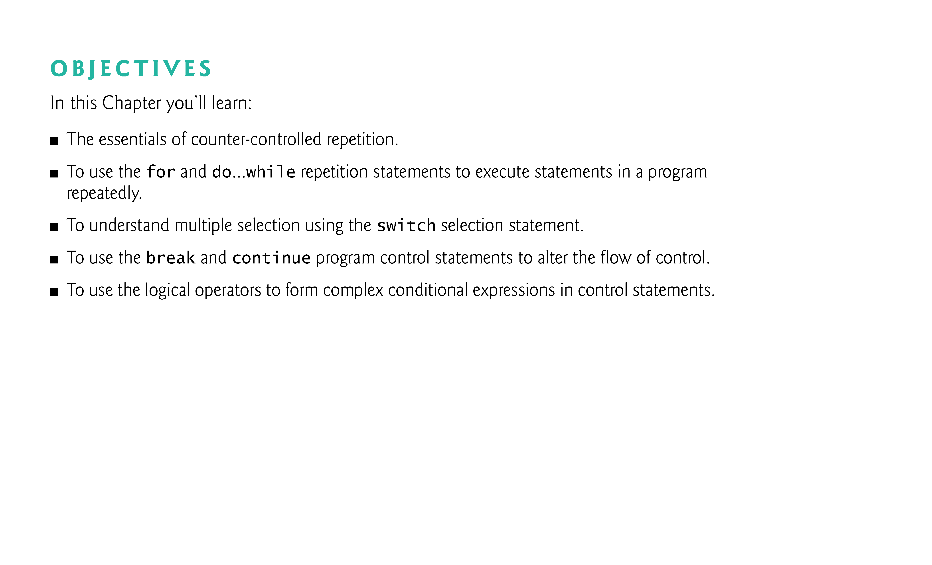

Slide 3
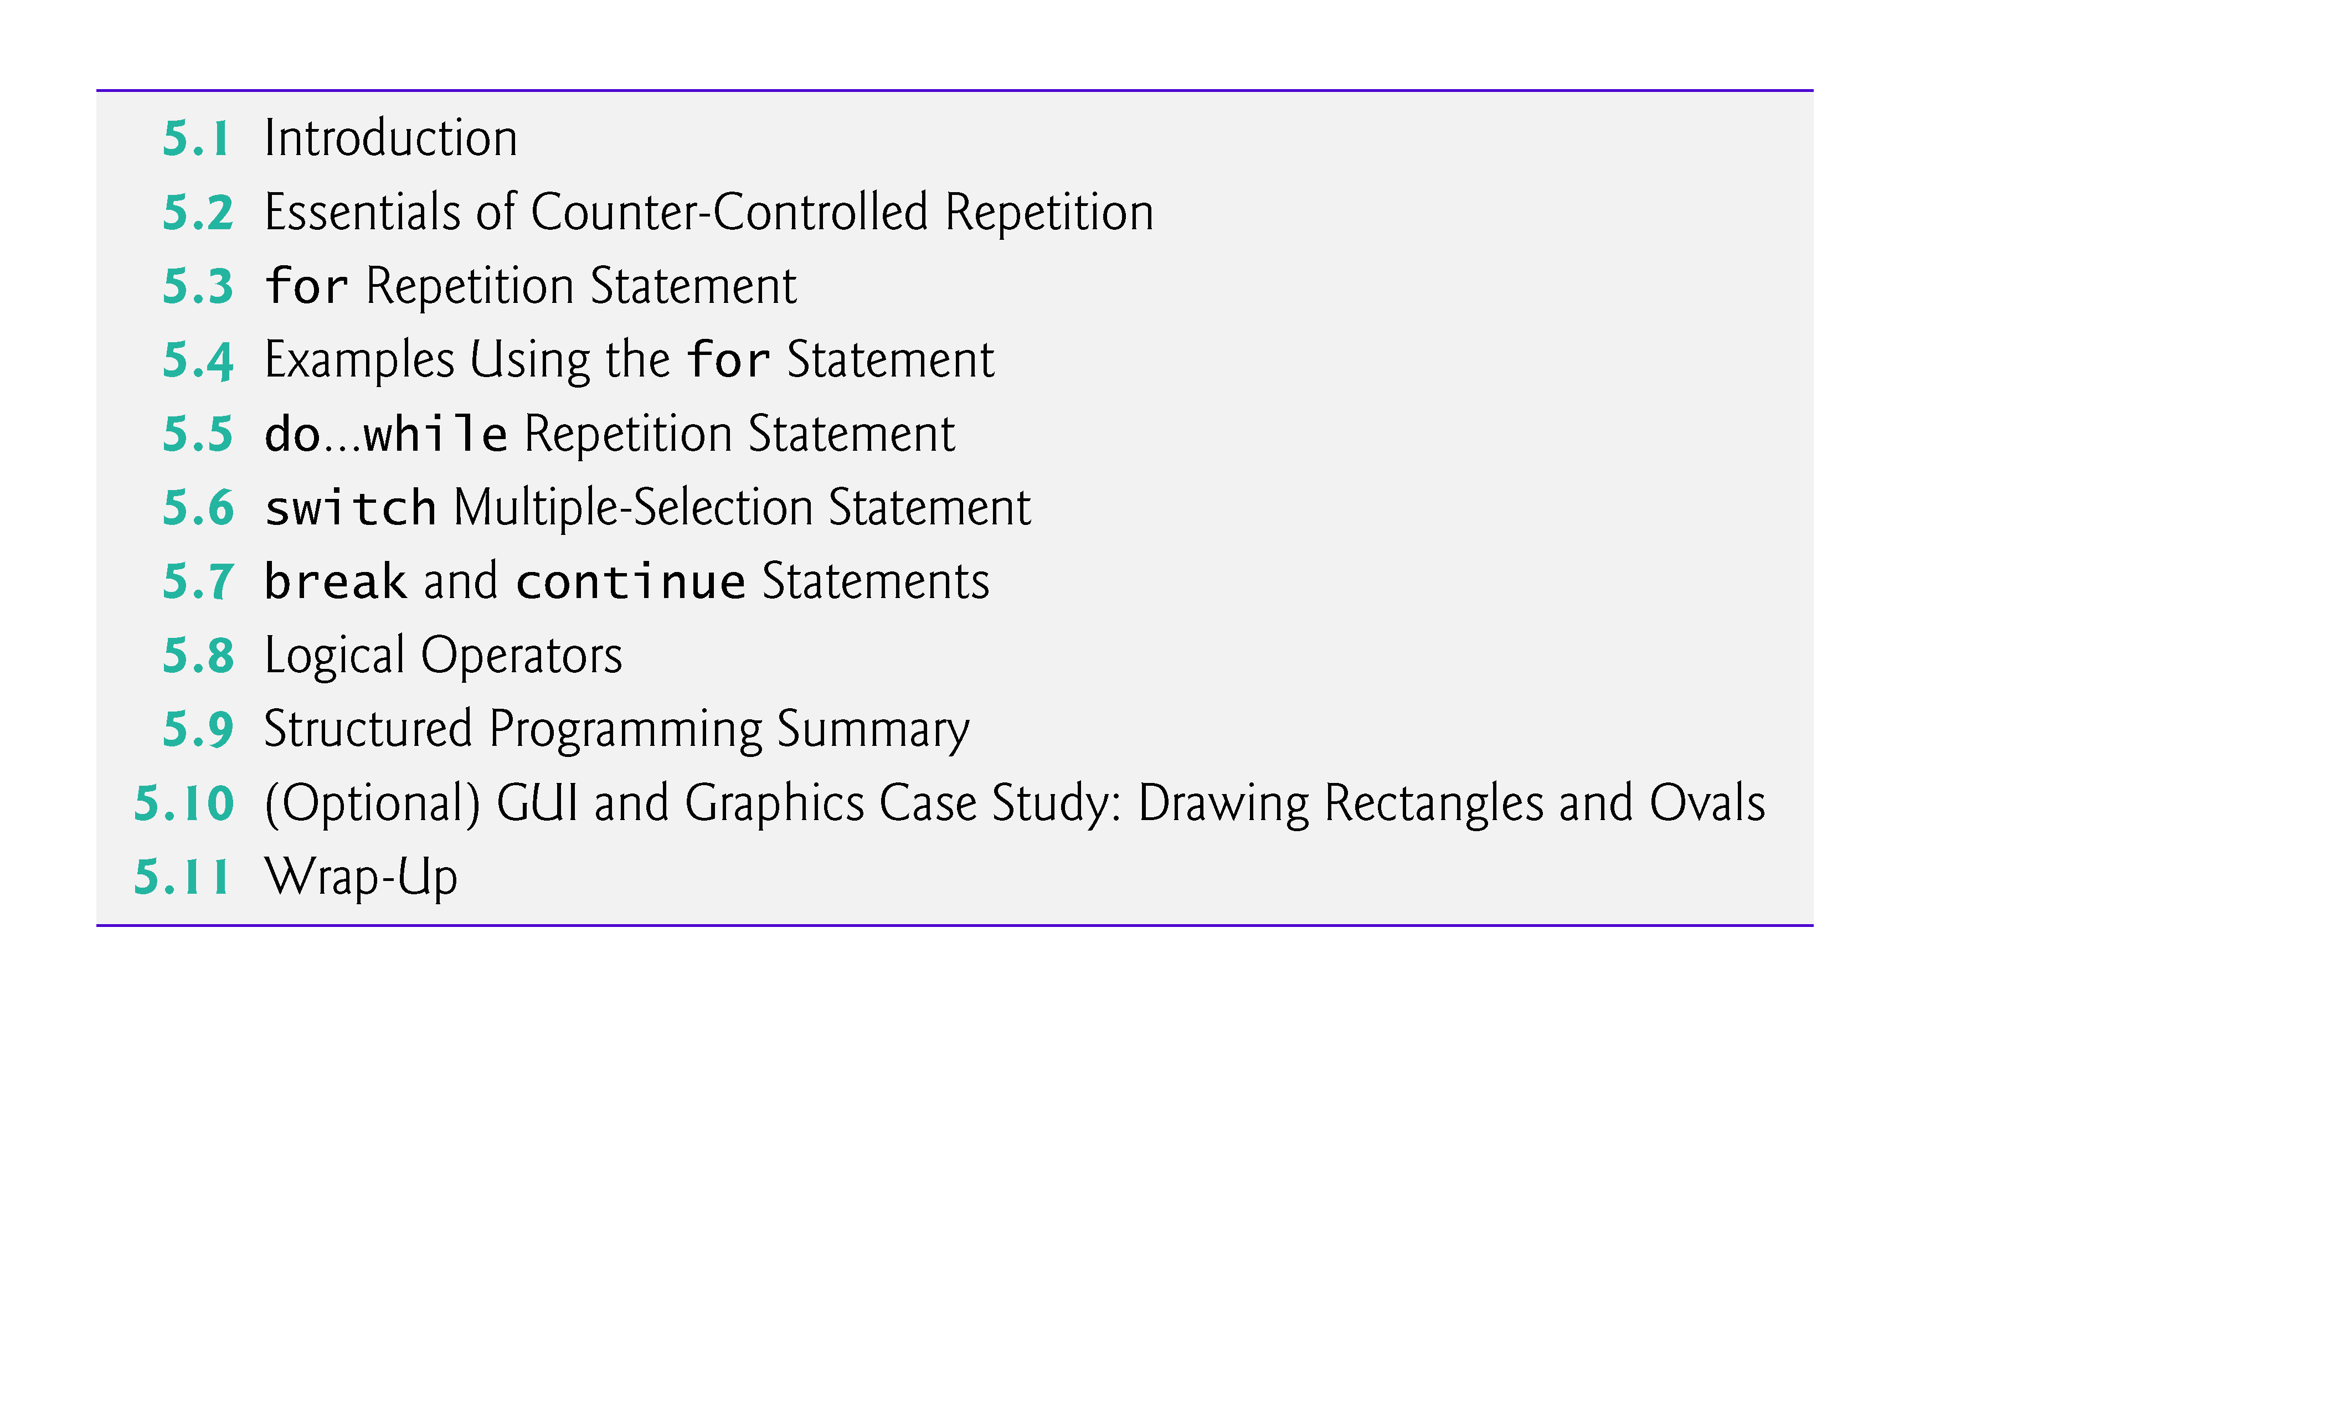

Slide 4
5.1 Introduction
for repetition statement
do…while repetition statement
switch multiple-selection statement
break statement
continue statement
Logical operators
Control statements summary.

Slide 5
5.2 Essentials of Counter-Controlled Repetition
Counter-controlled repetition requires
a control variable (or loop counter)
the initial value of the control variable
the increment (or decrement) by which the control variable is modified each time through the loop (also known as each iteration of the loop)
the loop-continuation condition that determines if looping should continue.

Slide 6
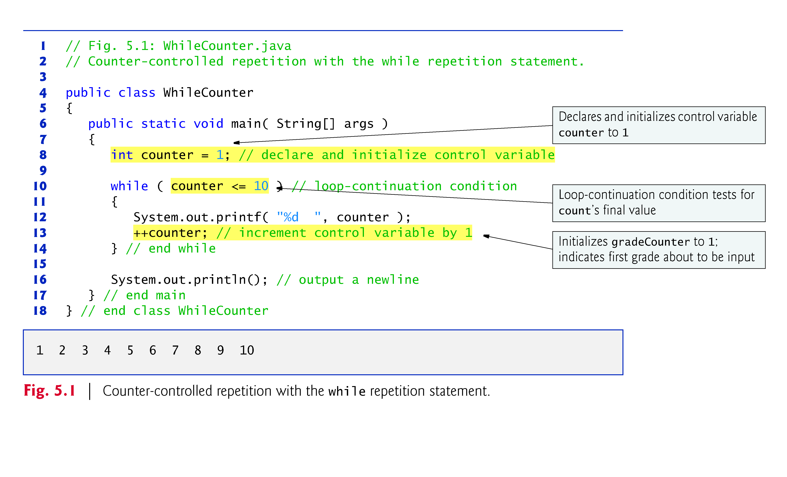

Slide 7
5.2 Essentials of Counter-Controlled Repetition (Cont.)
In Fig. 5.1, the elements of counter-controlled repetition are defined in lines 8, 10 and 13.
Line 8 declares the control variable (counter) as an int, reserves space for it in memory and sets its initial value to 1.
The loop-continuation condition in the while (line 10) tests whether the value of the control variable is less than or equal to 10 (the final value for which the condition is true).
Line 13 increments the control variable by 1 for each iteration of the loop.

Slide 8
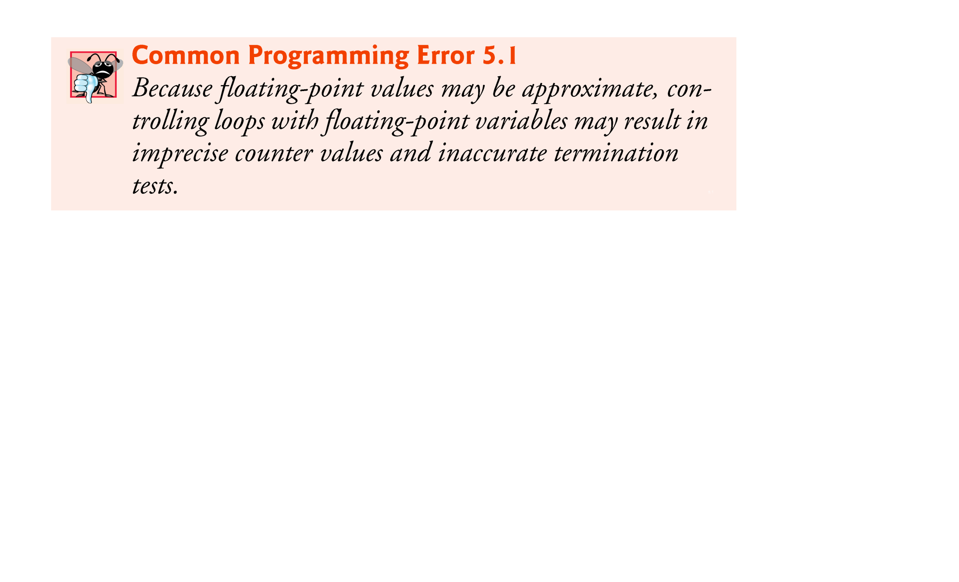

Slide 9
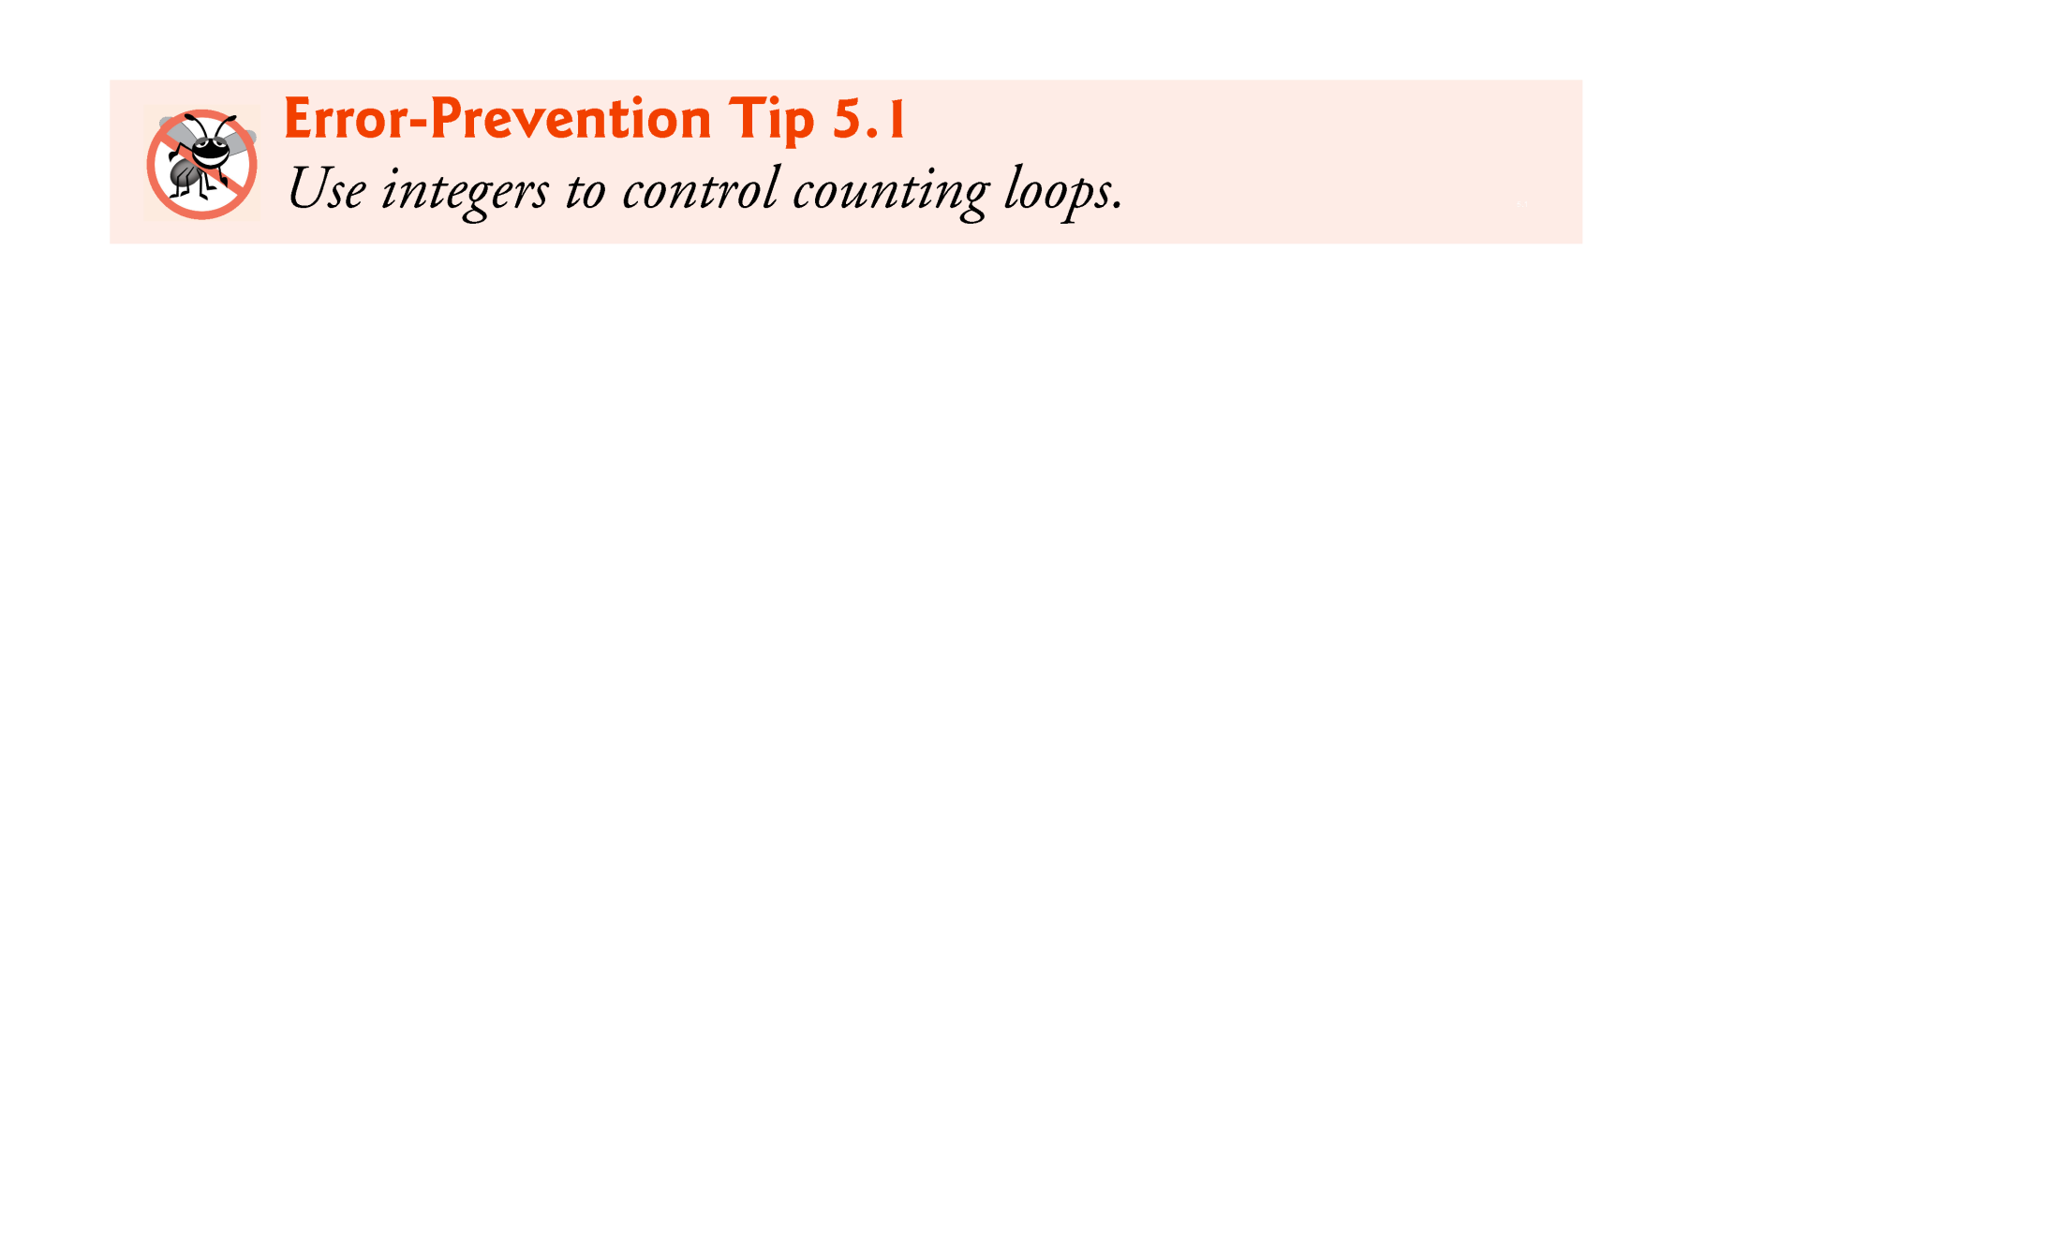

Slide 10
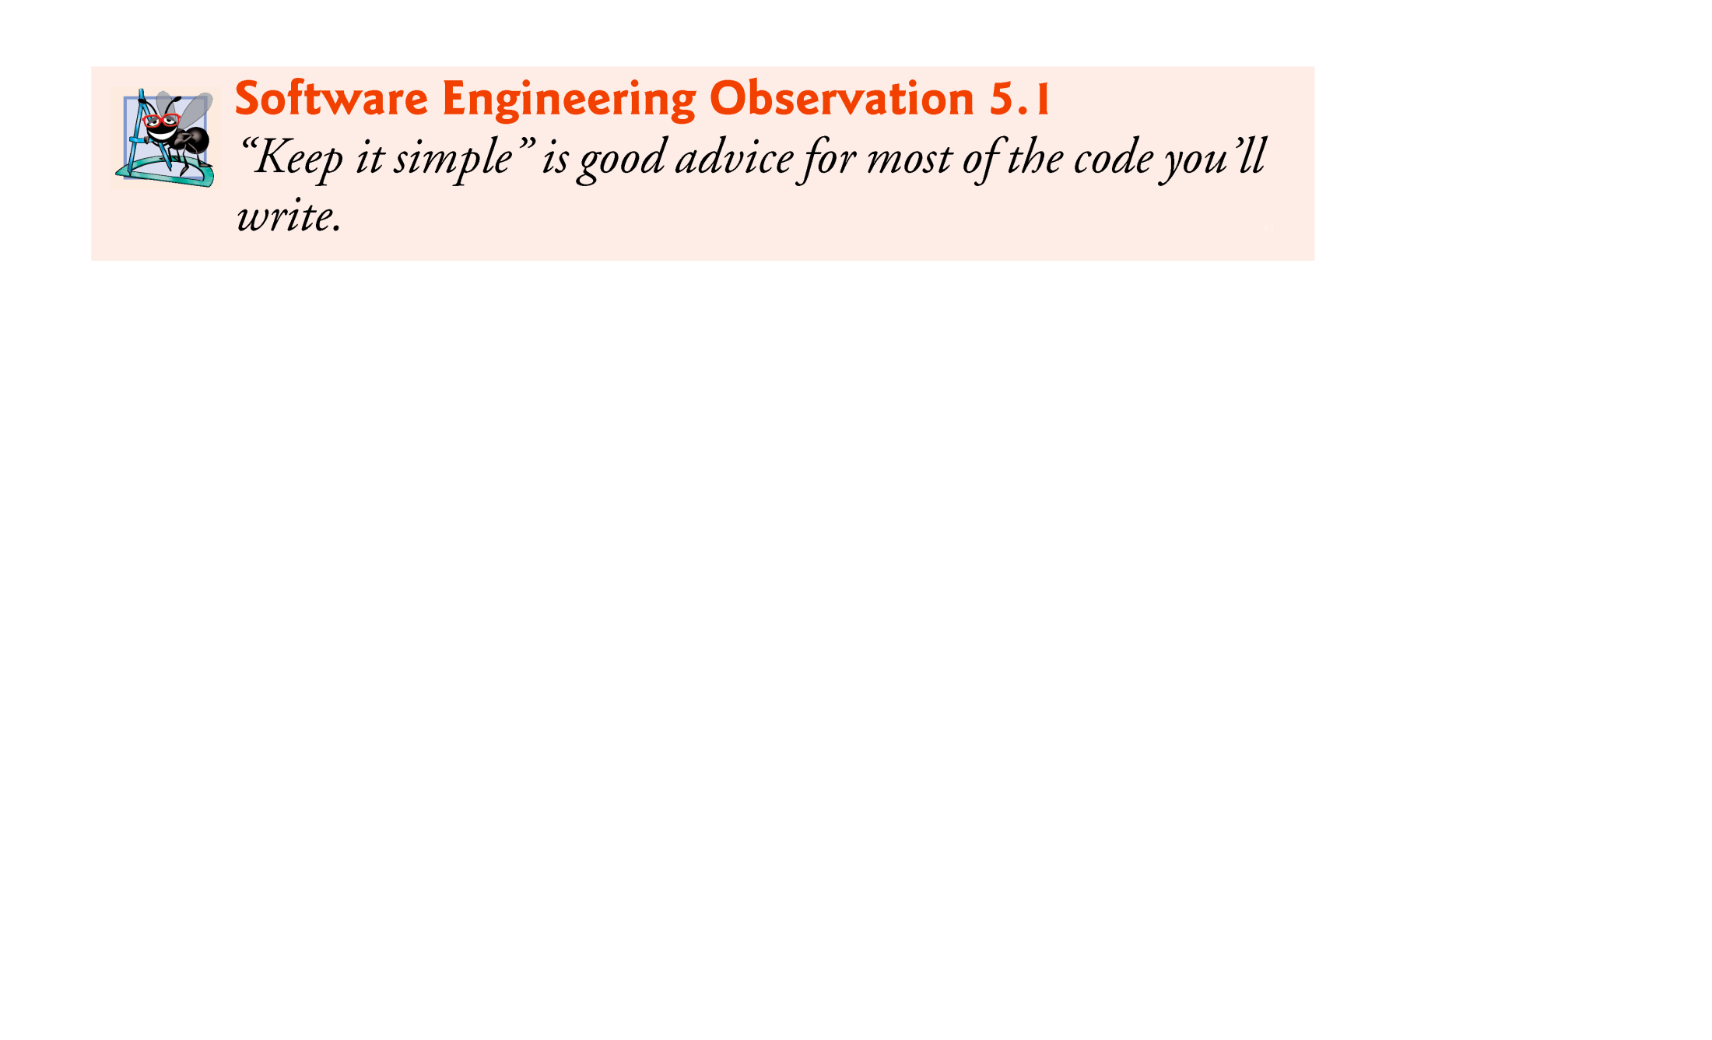

Slide 11
5.3 for Repetition Statement
for repetition statement
Specifies the counter-controlled-repetition details in a single line of code.
Figure 5.2 reimplements the application of Fig. 5.1 using for.

Slide 12
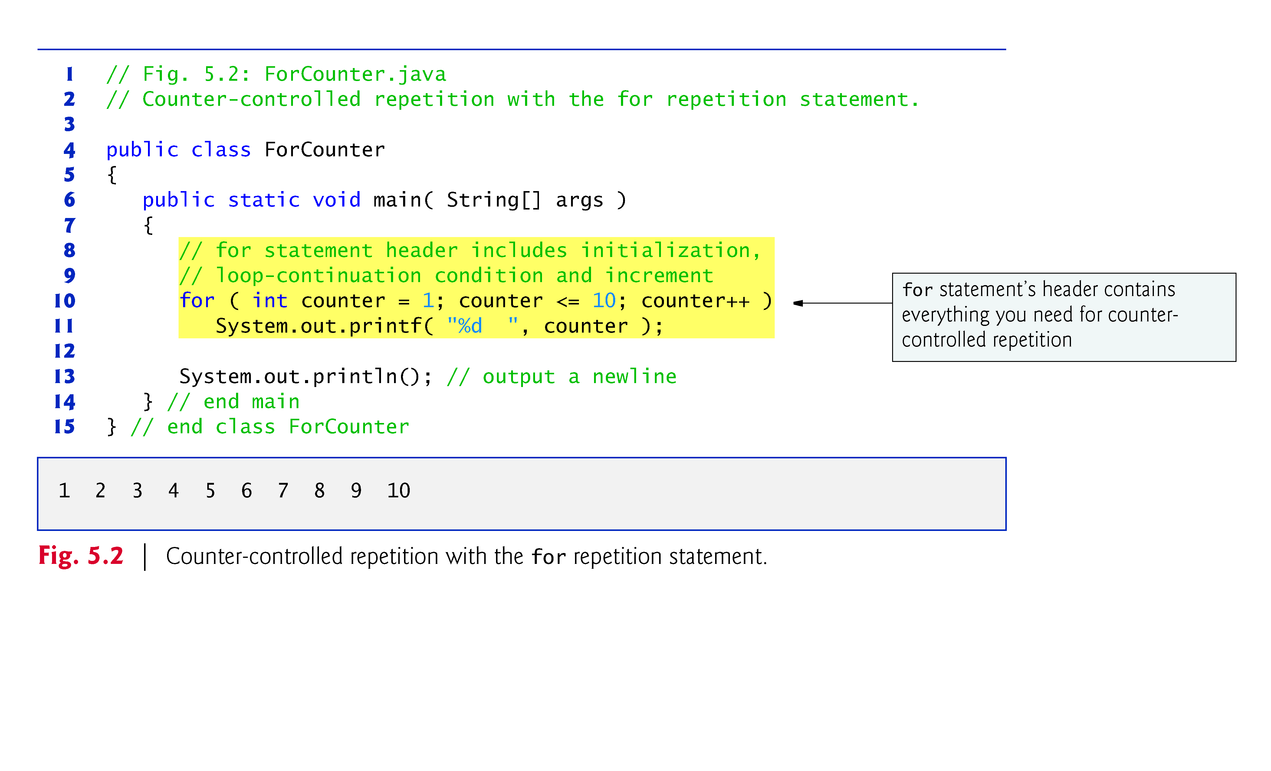

Slide 13
5.3 for Repetition Statement (Cont.)
When the for statement begins executing, the control variable is declared and initialized.
Next, the program checks the loop-continuation condition, which is between the two required semicolons.
If the condition initially is true, the body statement executes.
After executing the loop’s body, the program increments the control variable in the increment expression, which appears to the right of the second semicolon.
Then the loop-continuation test is performed again to determine whether the program should continue with the next iteration of the loop.
A common logic error with counter-controlled repetition is an off-by-one error.

Slide 14
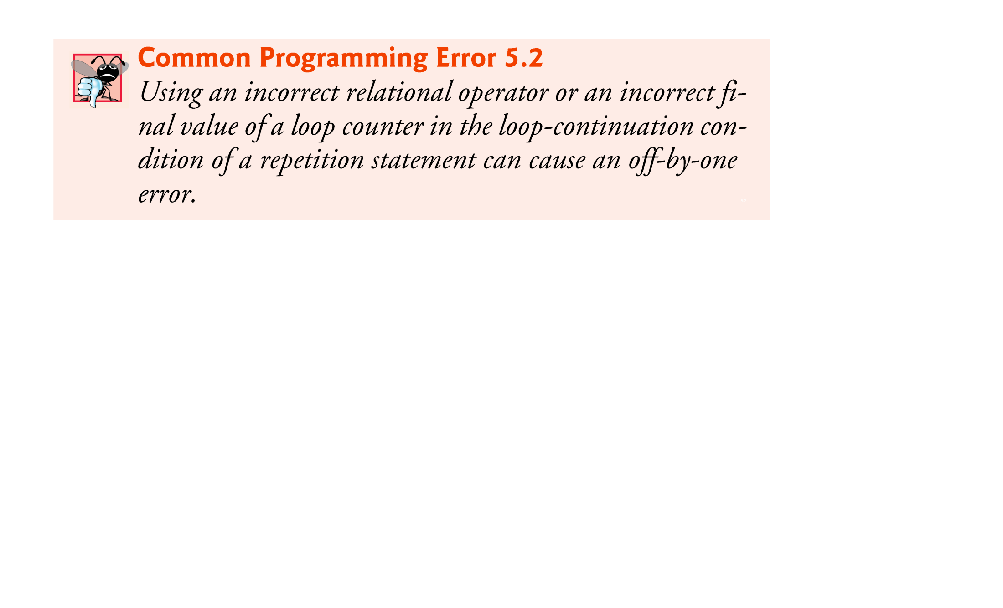

Slide 15
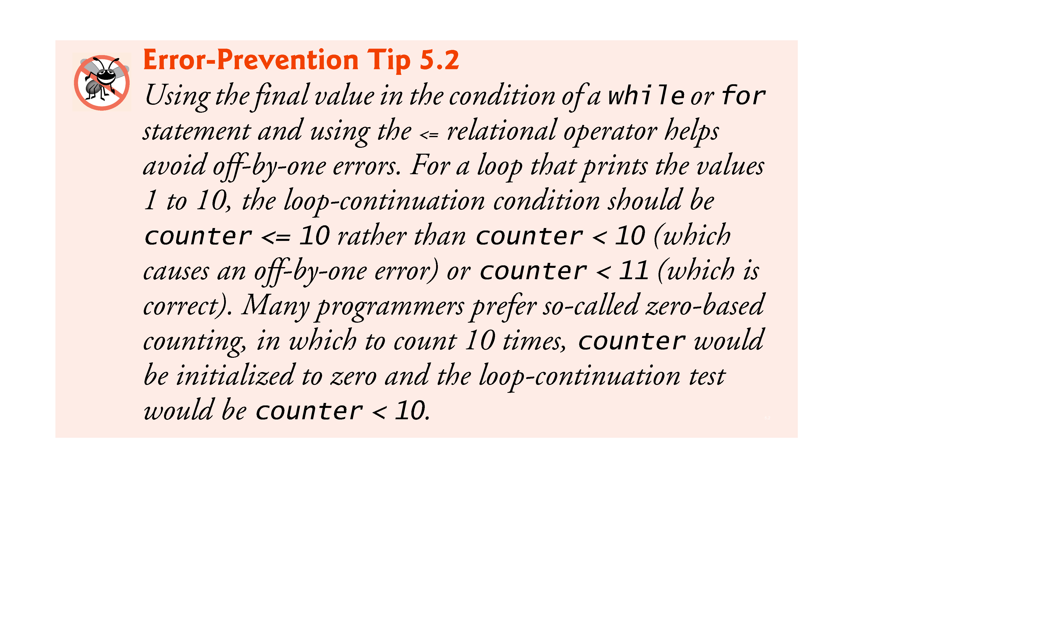

Slide 16
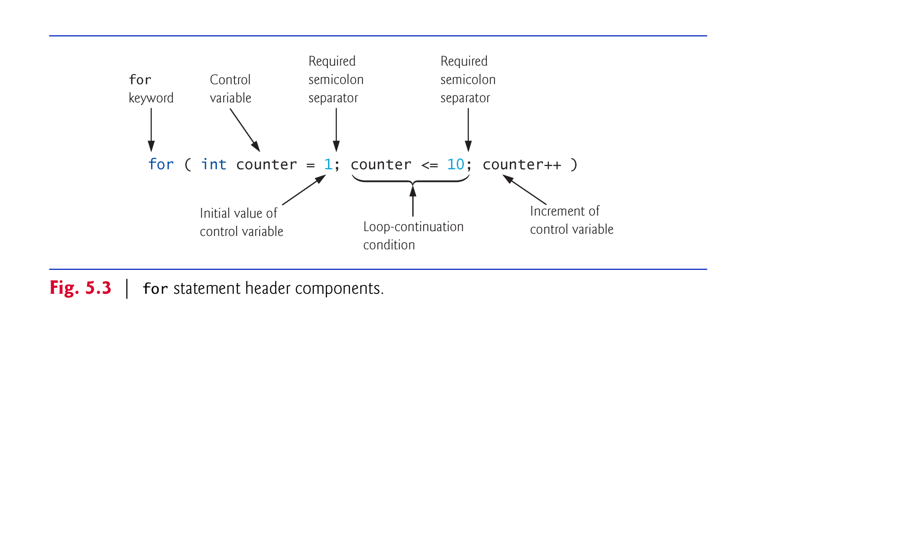

Slide 17
5.3 for Repetition Statement (Cont.)
The general format of the for statement is
for ( initialization; loopContinuationCondition; increment ) statement
the initialization expression names the loop’s control variable and optionally provides its initial value
loopContinuationCondition determines whether the loop should continue executing
increment modifies the control variable’s value (possibly an increment or decrement), so that the loop-continuation condition eventually becomes false.
The two semicolons in the for header are required.

Slide 18
5.3 for Repetition Statement (Cont.)
In most cases, the for statement can be represented with an equivalent while statement as follows:
initialization;
while ( loopContinuationCondition ) { statement increment; }
Typically, for statements are used for counter-controlled repetition and while statements for sentinel-controlled repetition.
If the initialization expression in the for header declares the control variable, the control variable can be used only in that for statement.

Slide 19
5.3 for Repetition Statement (Cont.)
A variable’s scope defines where it can be used in a program.
A local variable can be used only in the method that declares it and only from the point of declaration through the end of the method.

Slide 20
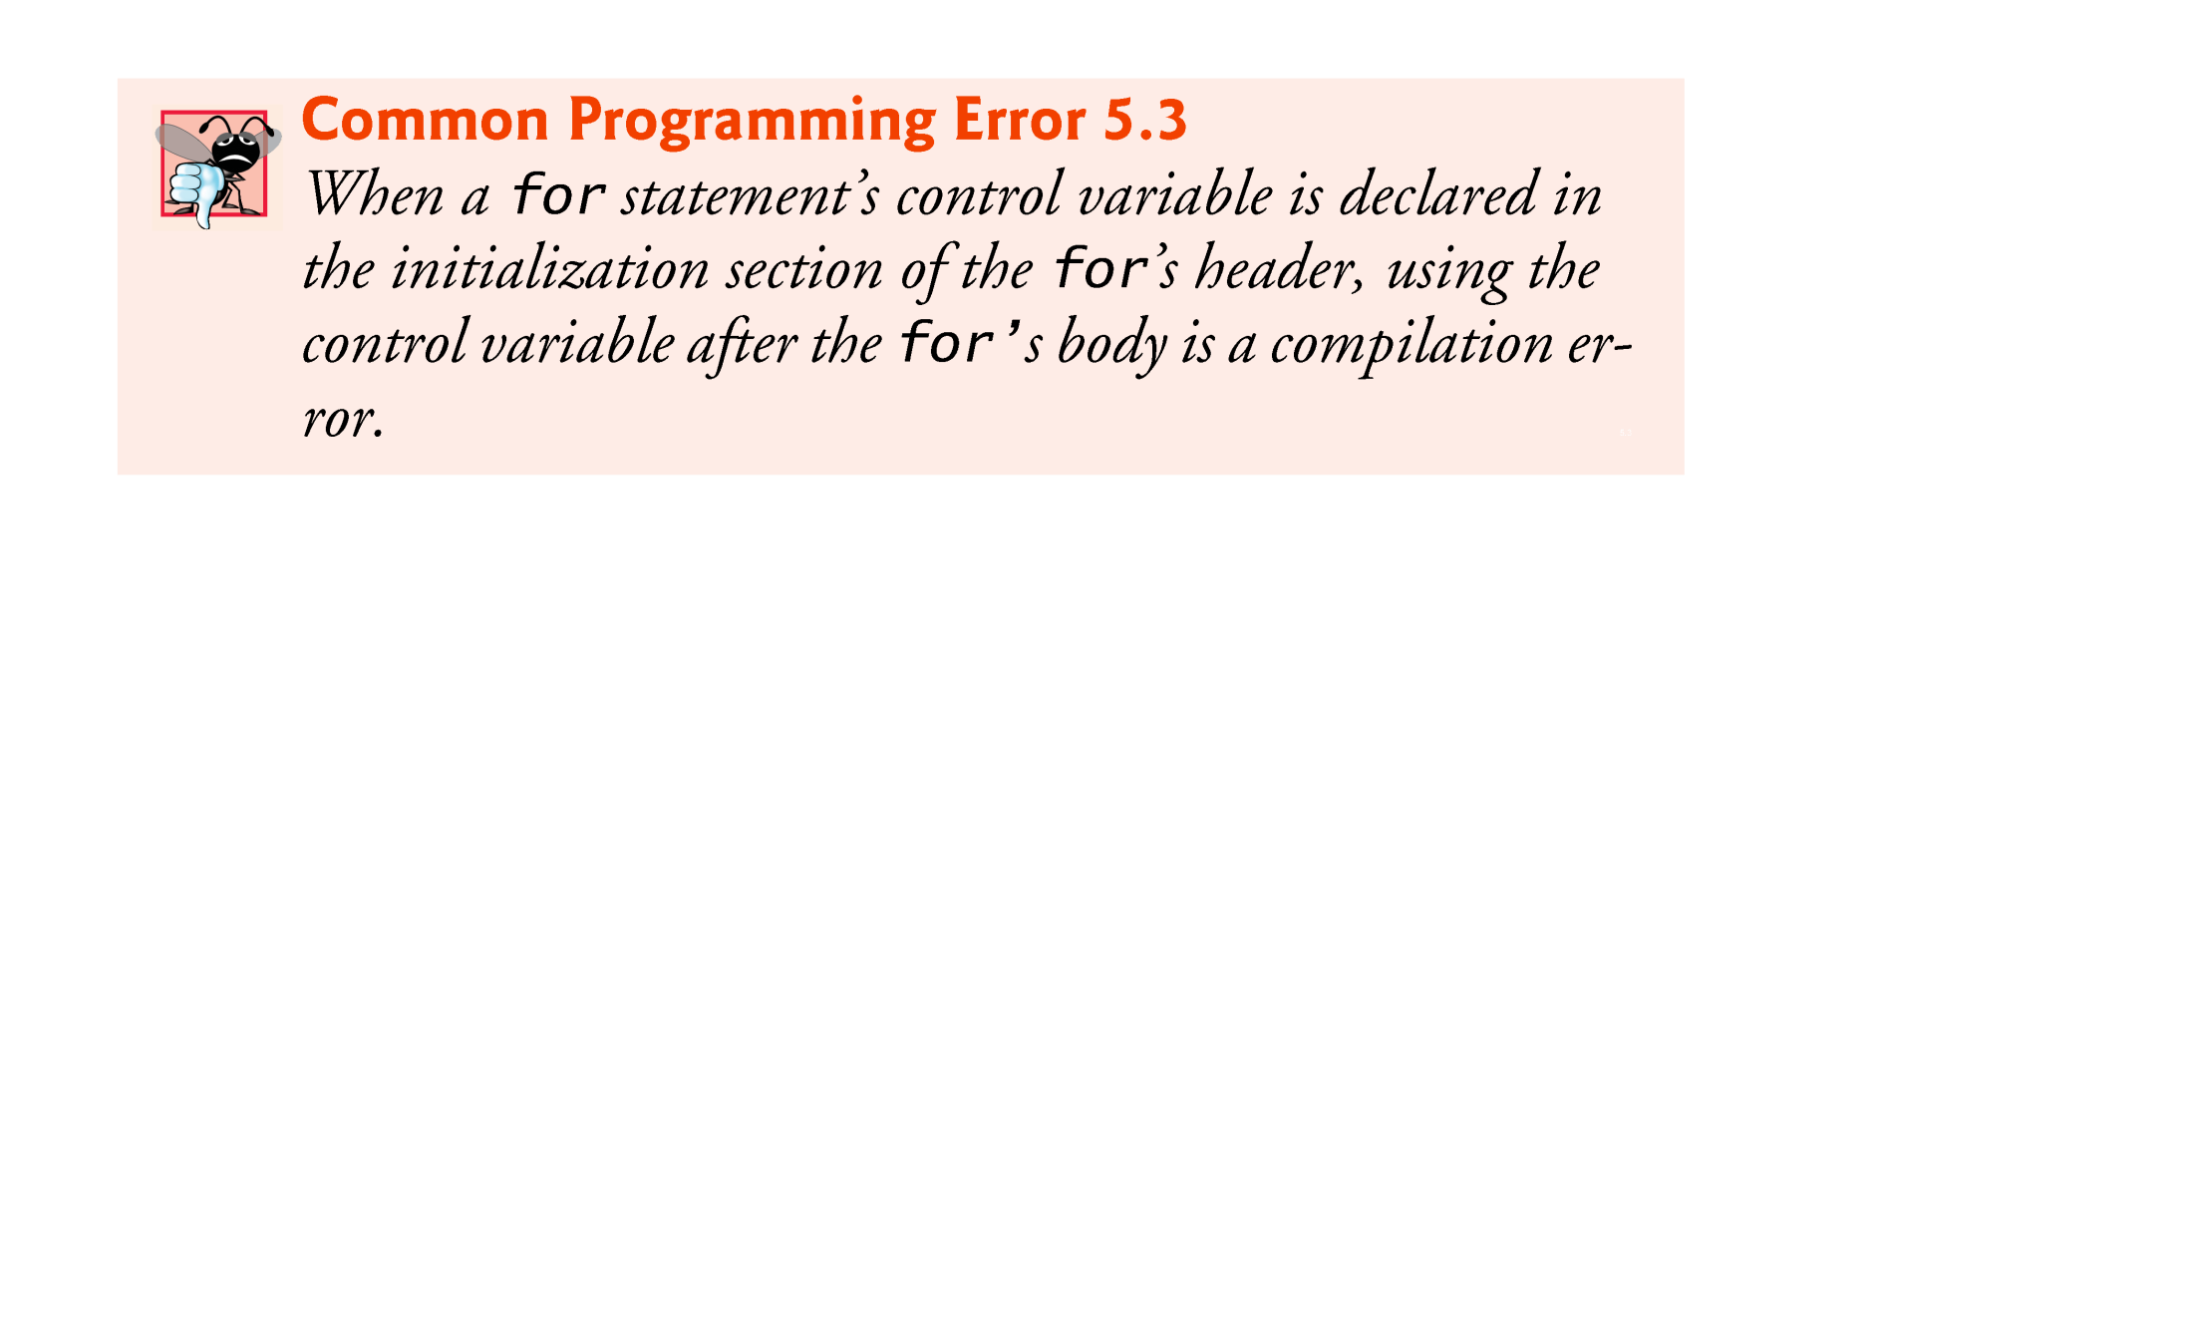

Slide 21
5.3 for Repetition Statement (Cont.)
All three expressions in a for header are optional.
If the loopContinuationCondition is omitted, the condition is always true, thus creating an infinite loop.
You might omit the initialization expression if the program initializes the control variable before the loop.
You might omit the increment if the program calculates it with statements in the loop’s body or if no increment is needed.
The increment expression in a for acts as if it were a standalone statement at the end of the for’s body, so
counter = counter + 1 counter += 1 ++counter counter++
are equivalent increment expressions in a for statement.

Slide 22
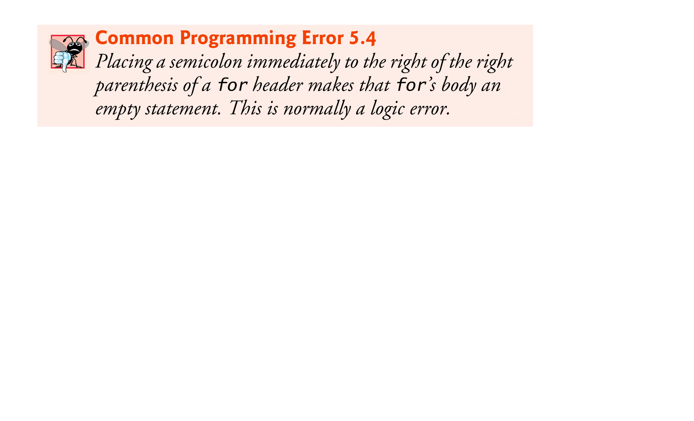

Slide 23
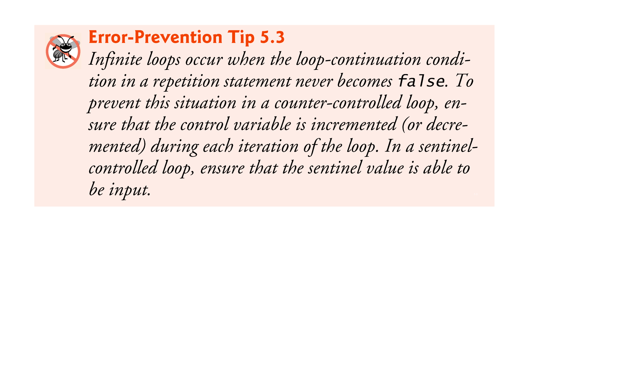

Slide 24
5.3 for Repetition Statement (Cont.)
The initialization, loop-continuation condition and increment can contain arithmetic expressions.
For example, assume that x = 2 and y = 10. If x and y are not modified in the body of the loop, the statement
for (int j = x; j <= 4 * x * y; j += y / x)
is equivalent to the statement
for (int j = 2; j <= 80; j += 5)
The increment of a for statement may be negative, in which case it’s a decrement, and the loop counts downward.

Slide 25
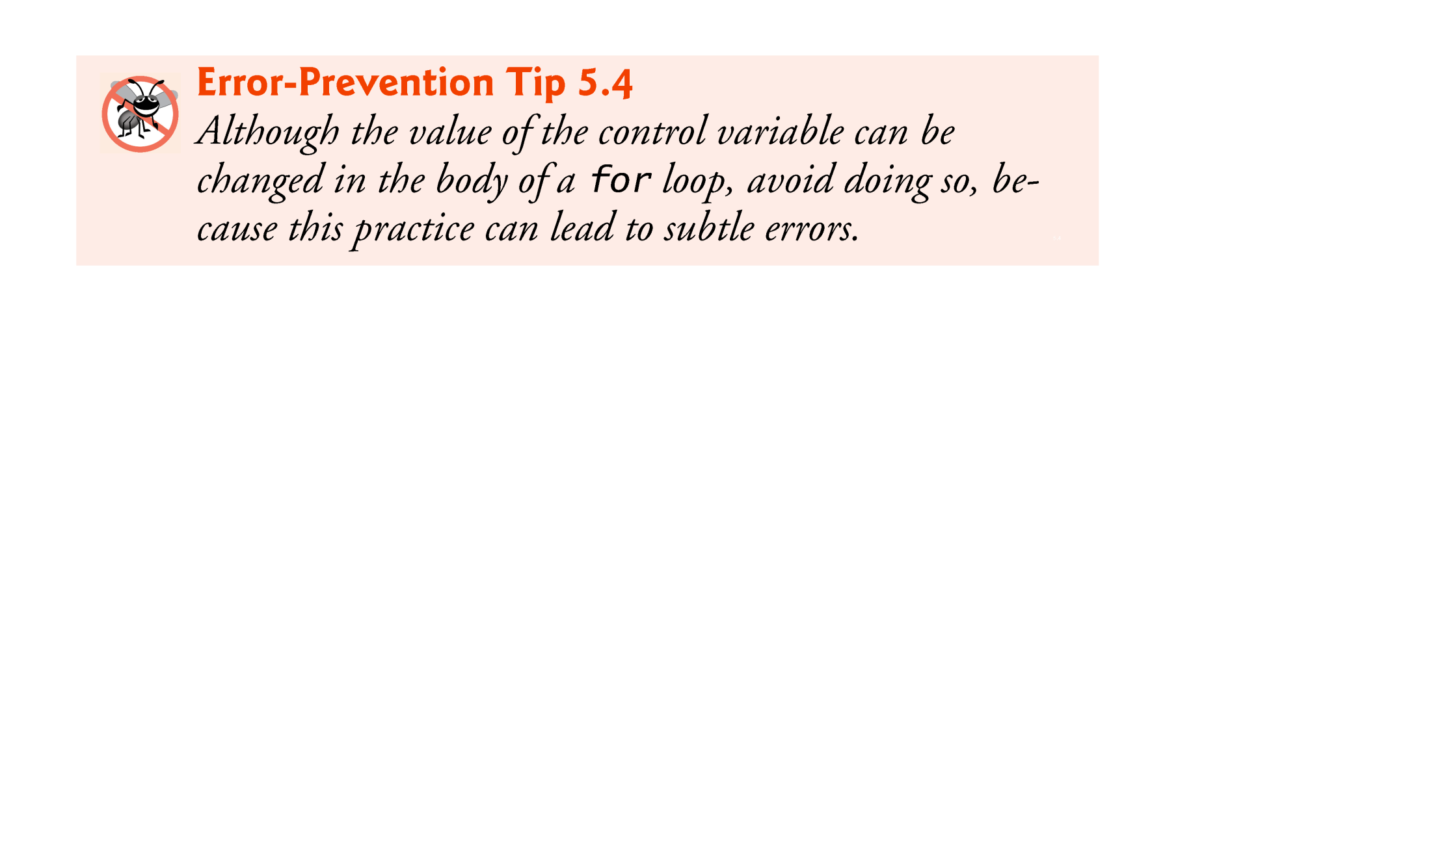

Slide 26
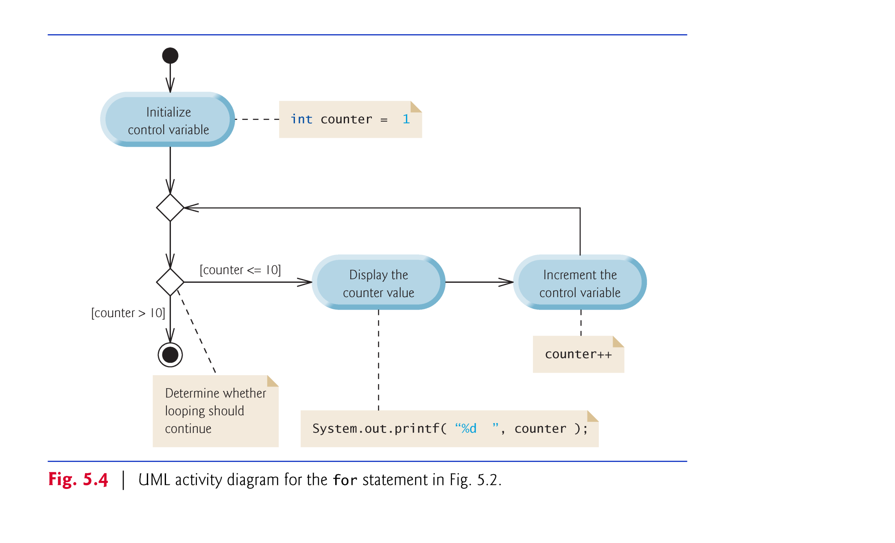

Slide 27
5.4 Examples Using the for Statement
a)Vary the control variable from 1 to 100 in increments of 1.
for ( int i = 1; i <= 100; i++ )
b)Vary the control variable from 100 to 1 in decrements of 1.
for ( int i = 100; i >= 1; i-- )
c)Vary the control variable from 7 to 77 in increments of 7.
for ( int i = 7; i <= 77; i += 7 )

Slide 28
5.4 Examples Using the for Statement (Cont.)
d)Vary the control variable from 20 to 2 in decrements of 2.
for ( int i = 20; i >= 2; i -= 2 )
e)Vary the control variable over the values 2, 5, 8, 11, 14, 17, 20.
for ( int i = 2; i <= 20; i += 3 )
f)Vary the control variable over the values 99, 88, 77, 66, 55, 44, 33, 22, 11, 0.
for ( int i = 99; i >= 0; i -= 11 )

Slide 29
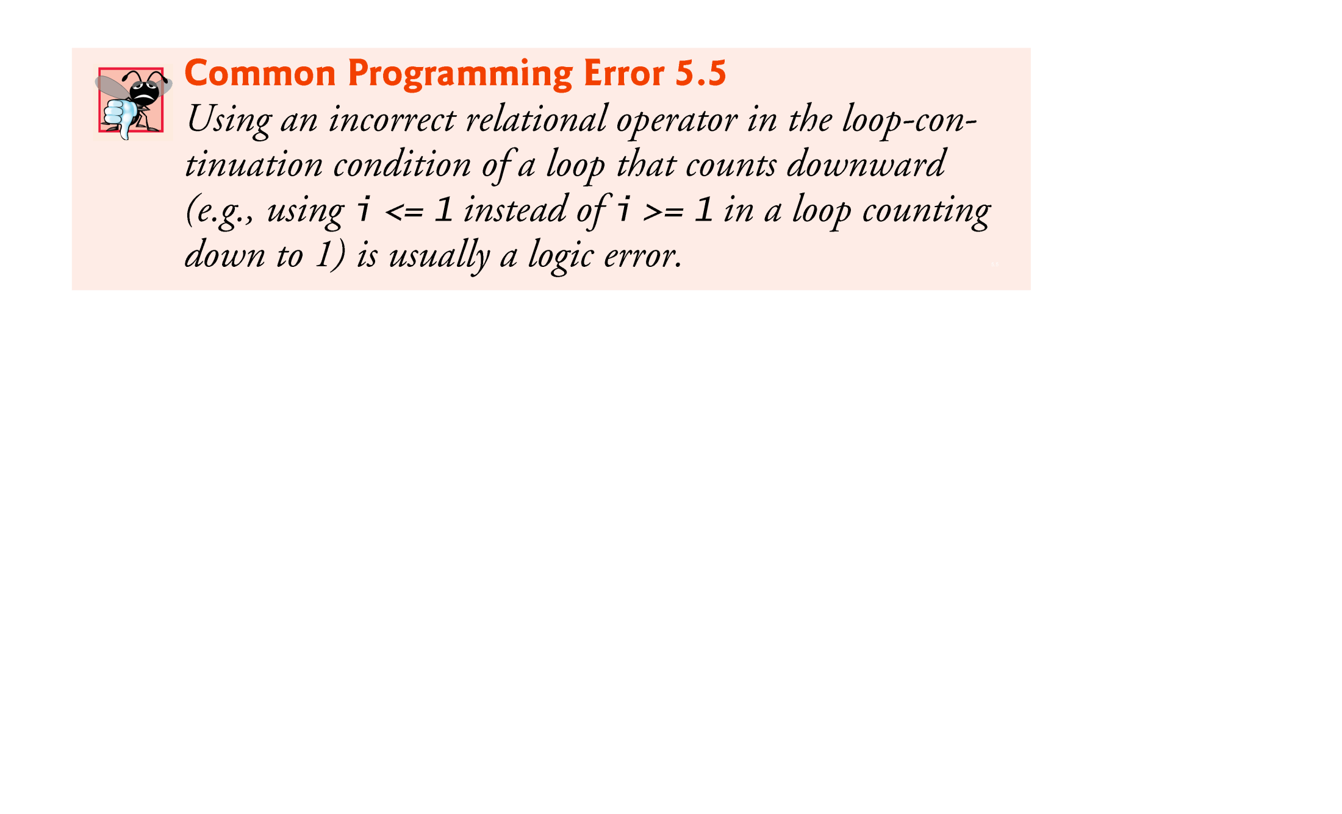

Slide 30
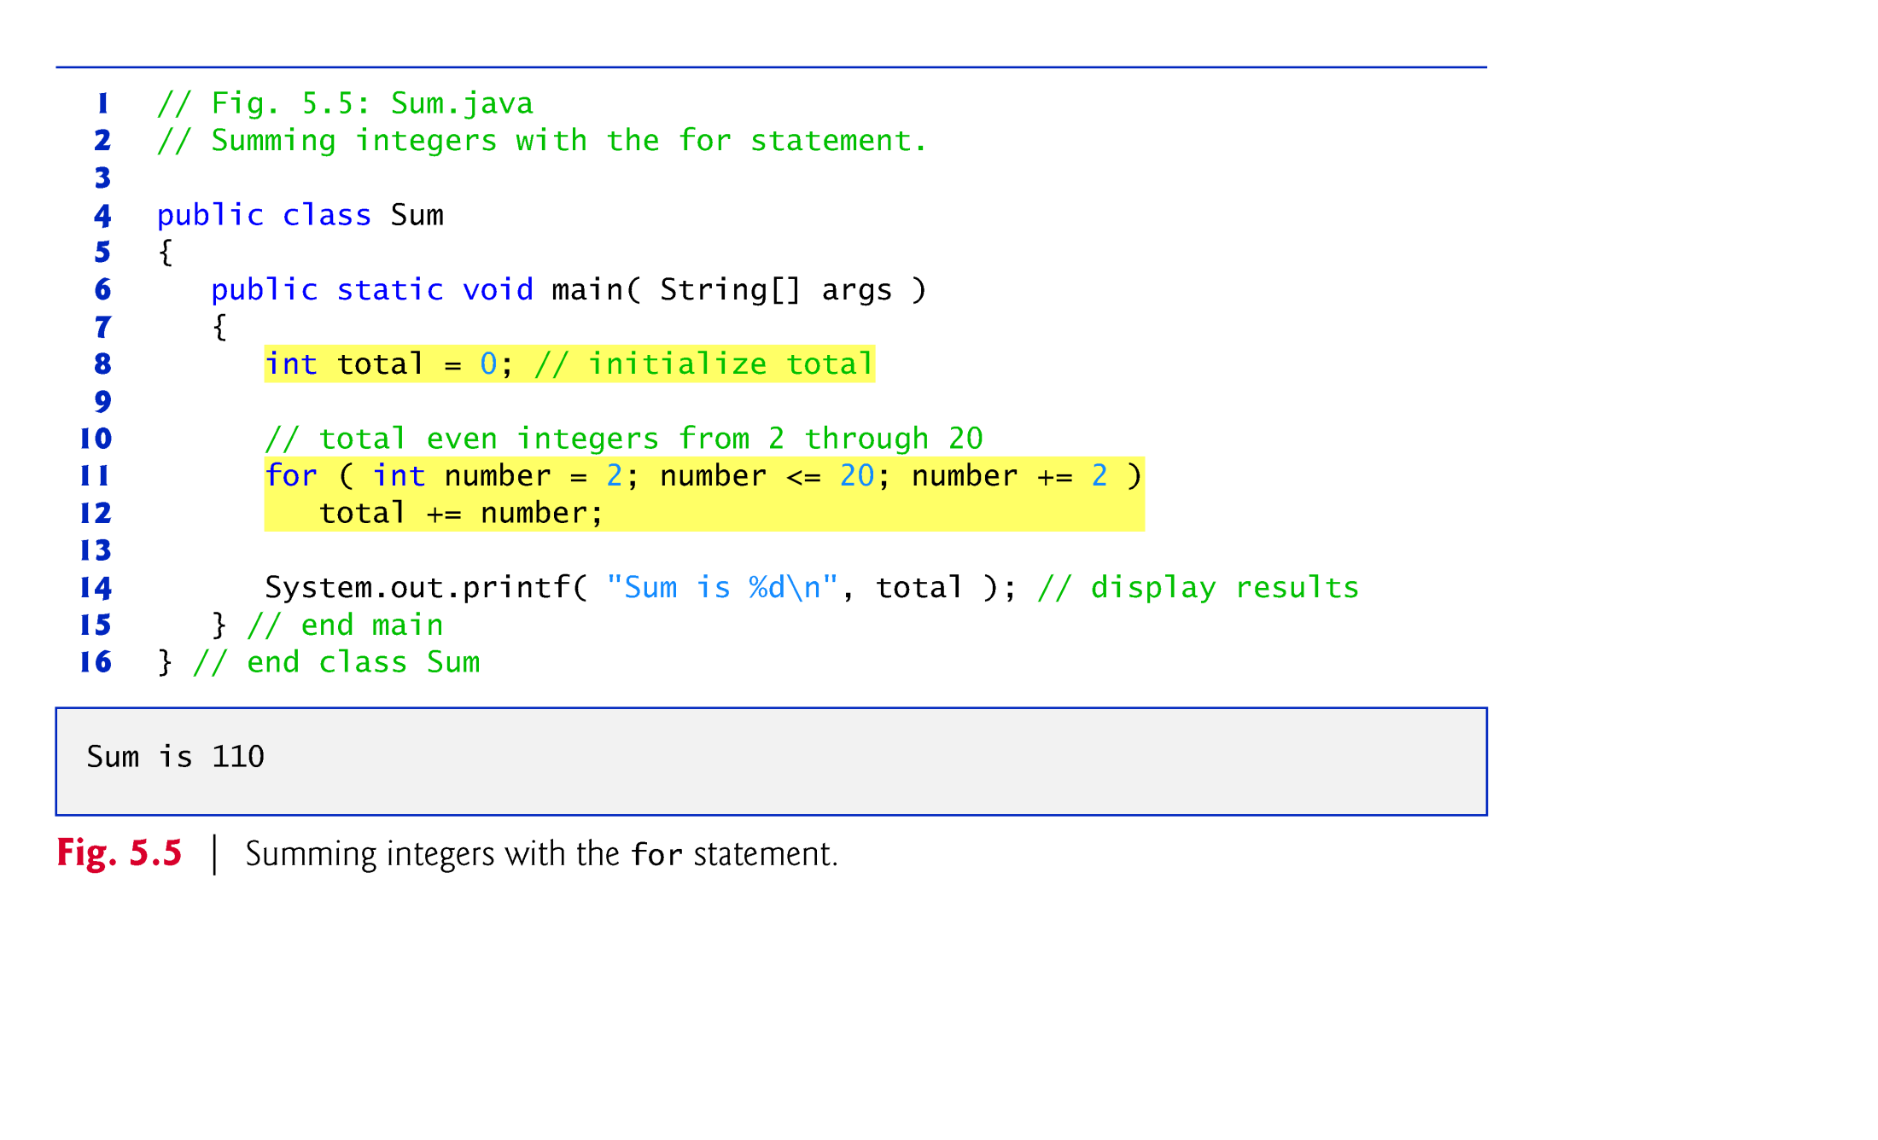

Slide 31
5.4 Examples Using the for Statement (Cont.)
The initialization and increment expressions can be comma-separated lists that enable you to use multiple initialization expressions or multiple increment expressions.
Although this is discouraged, the body of the for statement in lines 11–12 of Fig. 5.5 could be merged into the increment portion of the for header by using a comma as follows:
for ( int number = 2; number <= 20; total += number, number += 2 ) ; // empty statement

Slide 32


Slide 33
5.4 Examples Using the for Statement (Cont.)
Compound interest application
A person invests $1000 in a savings account yielding 5% interest. Assuming that all the interest is left on deposit, calculate and print the amount of money in the account at the end of each year for 10 years. Use the following formula to determine the amounts:
a = p (1 + r)^{n}
where
p is the original amount invested (i.e., the principal) r is the annual interest rate (e.g., use 0.05 for 5%) n is the number of years a is the amount on deposit at the end of the nth year.

Slide 34
5.4 Examples Using the for Statement (Cont.)
The solution to this problem (Fig. 5.6) involves a loop that performs the indicated calculation for each of the 10 years the money remains on deposit.
Java treats floating-point constants like 1000.0 and 0.05 as type double.
Java treats whole-number constants like 7 and -22 as type int.

Slide 35
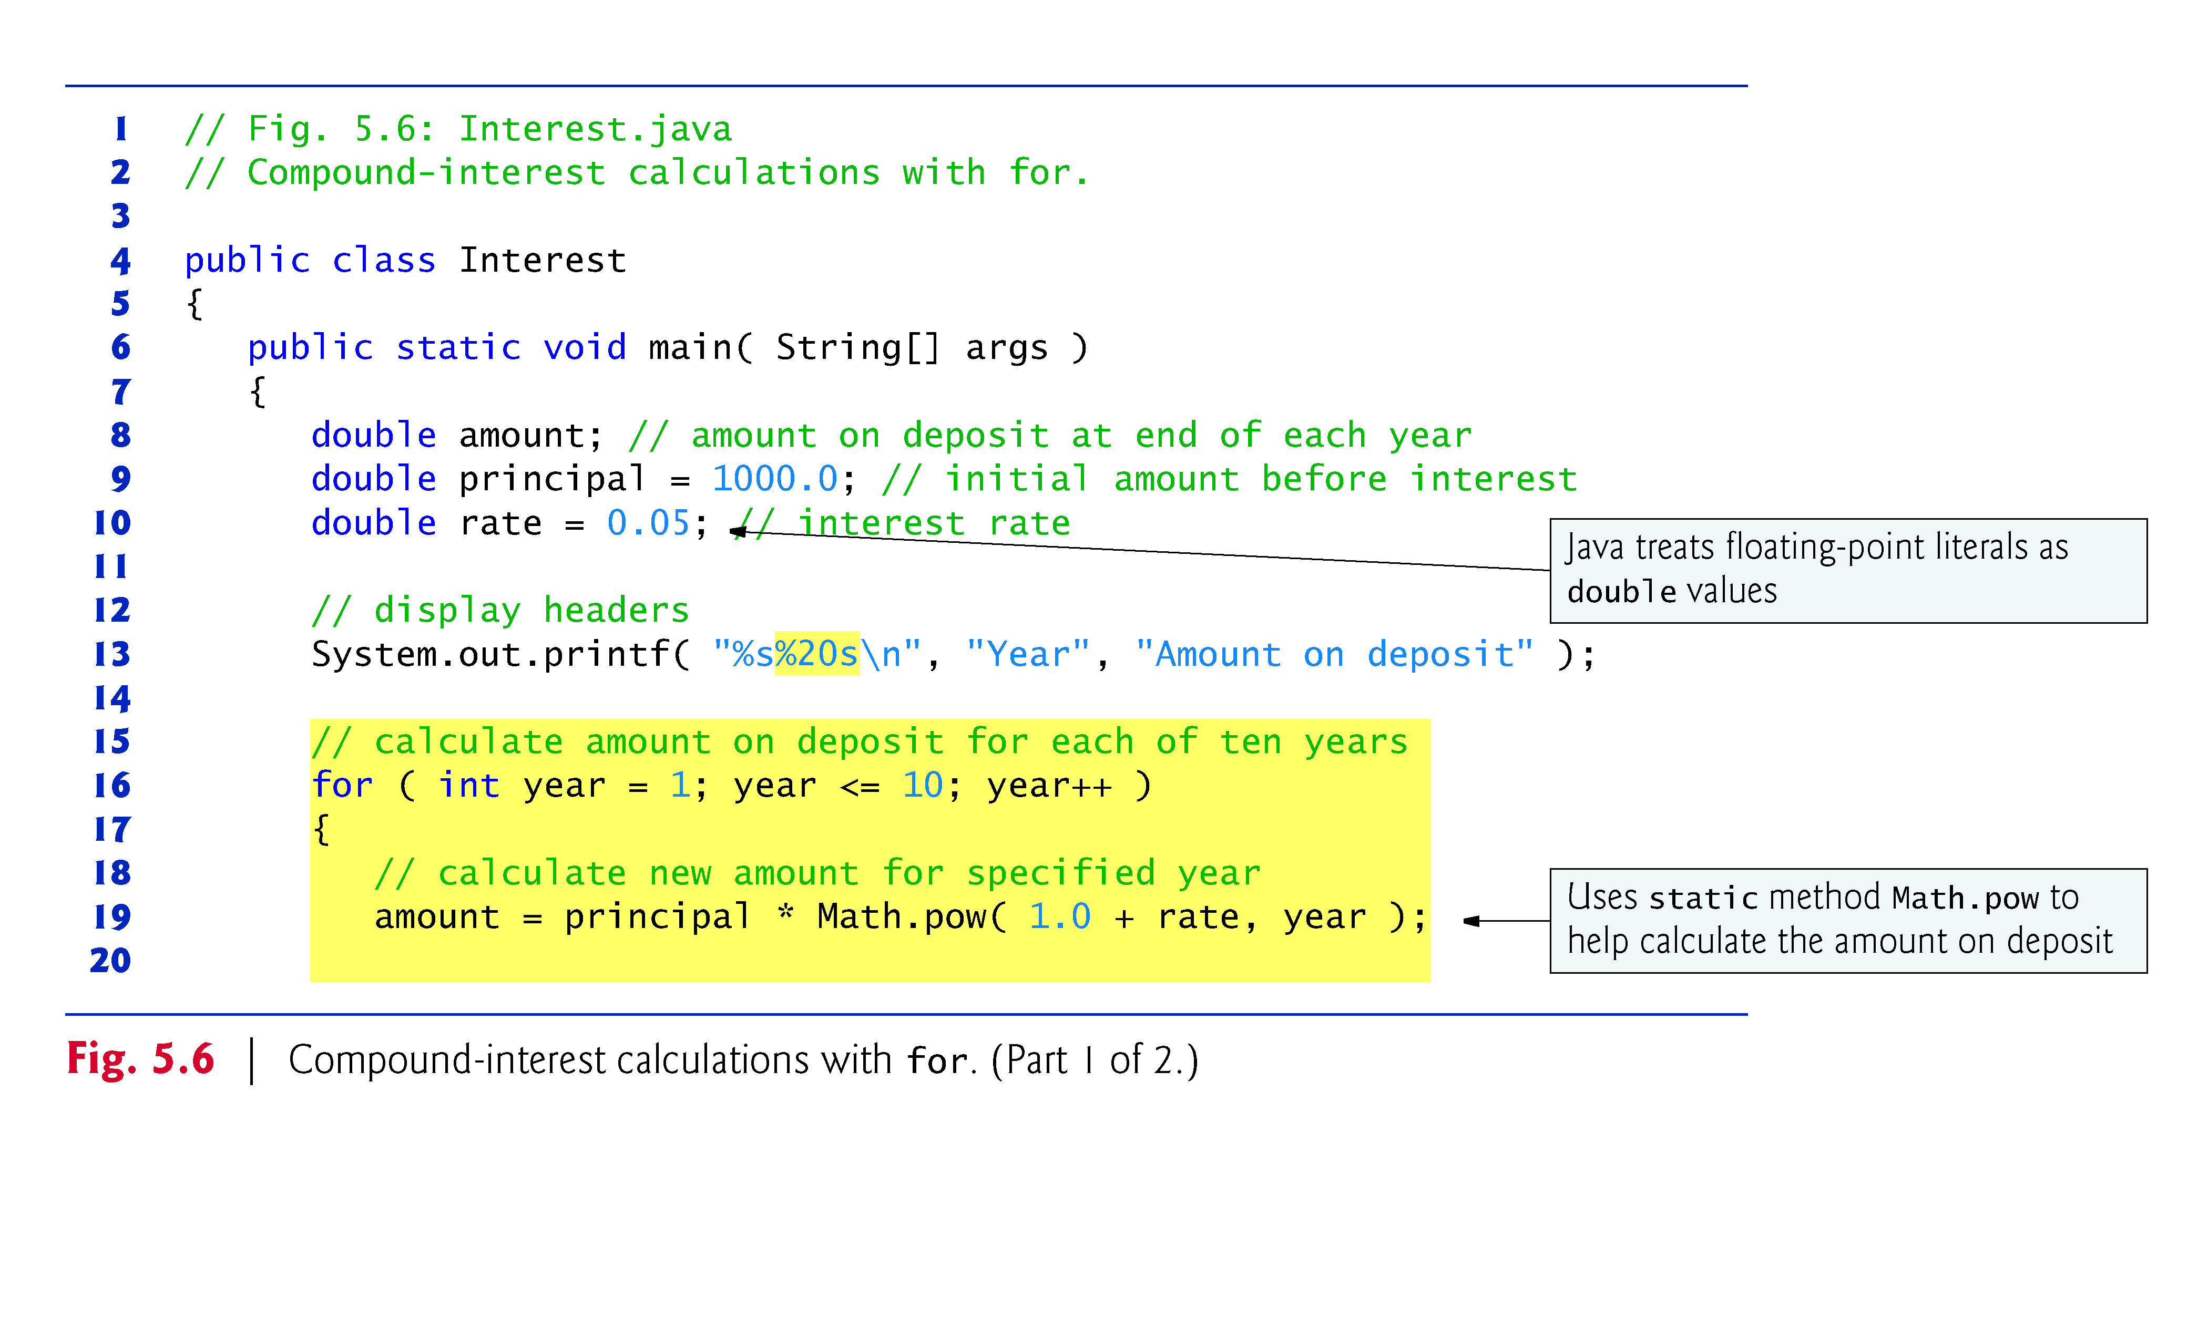

Slide 36
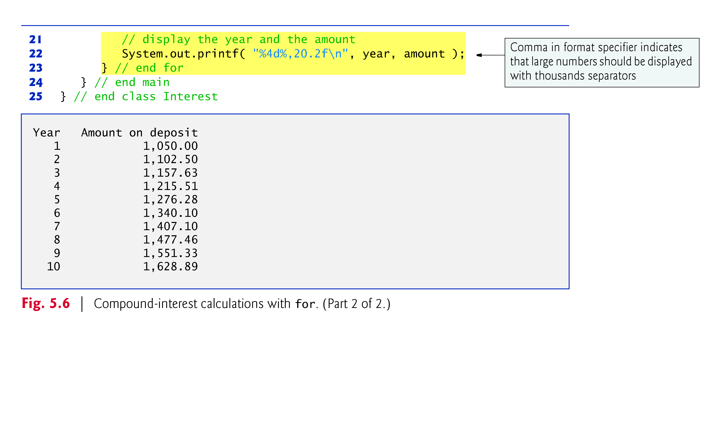

Slide 37
5.4 Examples Using the for Statement (Cont.)
In the format specifier %20s, the integer 20 between the % and the conversion character s indicates that the value output should be displayed with a field width of 20—that is, printf displays the value with at least 20 character positions.
If the value to be output is less than 20 character positions wide, the value is right justified in the field by default.
If the year value to be output were more thanhas more characters than the field width, the field width would be extended to the right to accommodate the entire value.
To indicate that values should be output left justified, precede the field width with the minus sign (–) formatting flag (e.g., %-20s).

Slide 38
5.4 Examples Using the for Statement (Cont.)
Classes provide methods that perform common tasks on objects.
Most methods must be called on a specific object.
Many classes also provide methods that perform common tasks and do not require objects. These are called static methods.
Java does not include an exponentiation operator—Math class static method pow can be used for raising a value to a power.
You can call a static method by specifying the class name followed by a dot (.) and the method name, as in
ClassName.methodName( arguments )
Math.pow(x, y) calculates the value of x raised to the y^{th} power. The method receives two double arguments and returns a double value.

Slide 39
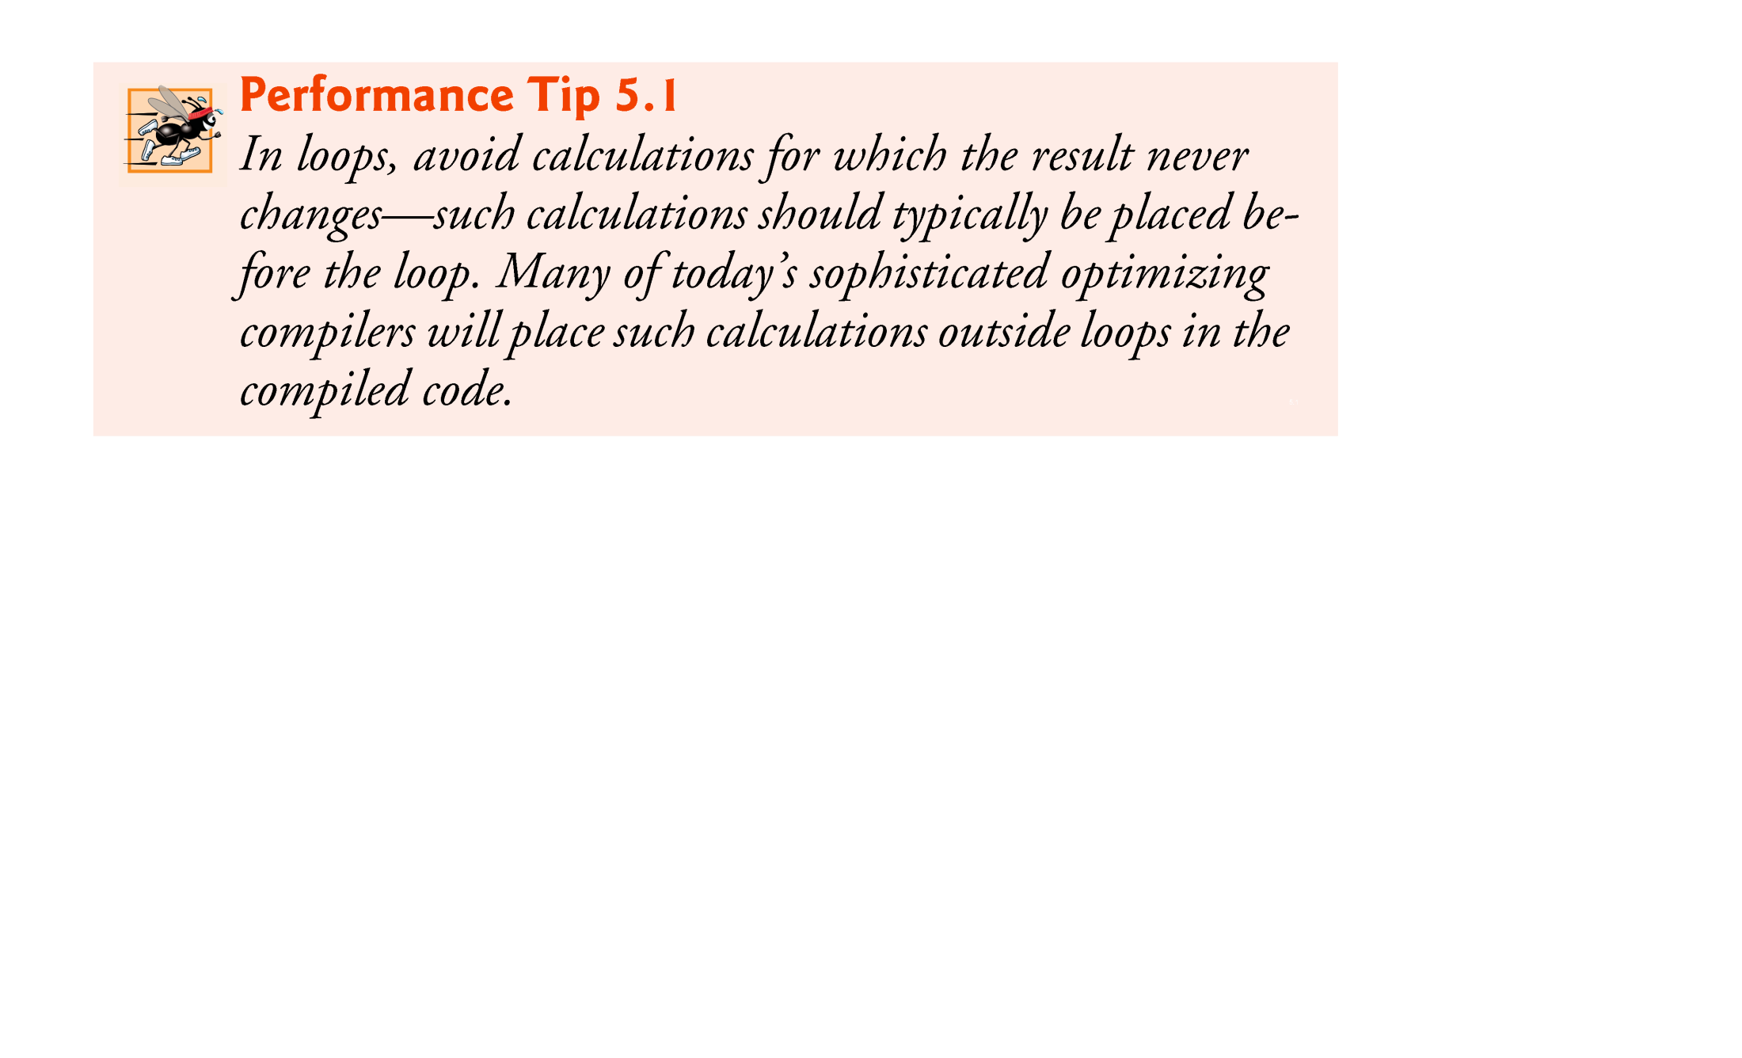

Slide 40
5.4 Examples Using the for Statement (Cont.)
In the format specifier %,20.2f, the comma (,) formatting flag indicates that the floating-point value should be output with a grouping separator.
Separator is specific to the user’s locale (i.e., country).
In the United States, the number will be output using commas to separate every three digits and a decimal point to separate the fractional part of the number, as in 1,234.45.
The number 20 in the format specification indicates that the value should be output right justified in a field width of 20 characters.
The .2 specifies the formatted number’s precision—in this case, the number is rounded to the nearest hundredth and output with two digits to the right of the decimal point.

Slide 41
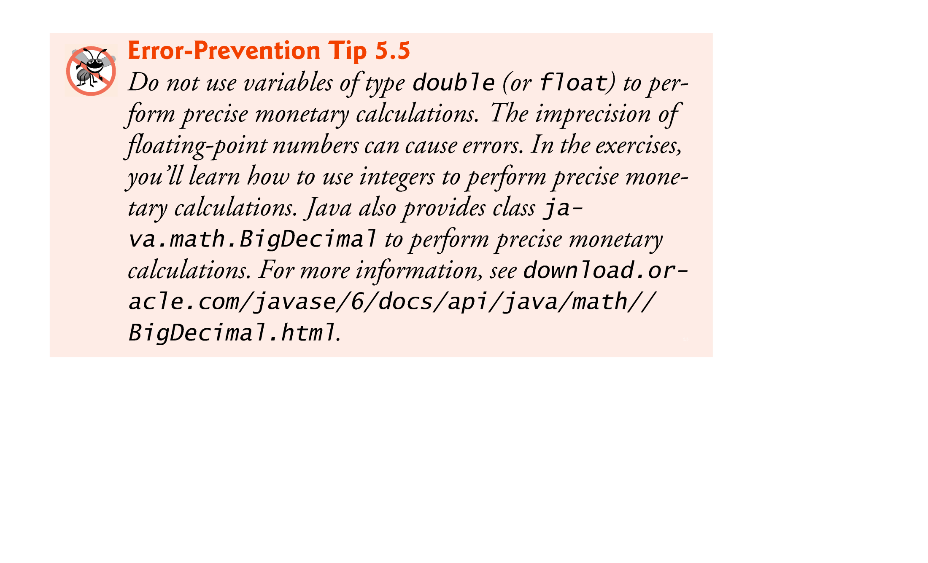

Slide 42
5.5 do…while Repetition Statement
The do…while repetition statement is similar to the while statement.
In the while, the program tests the loop-continuation condition at the beginning of the loop, before executing the loop’s body; if the condition is false, the body never executes.
The do…while statement tests the loop-continuation condition after executing the loop’s body; therefore, the body always executes at least once.
When a do…while statement terminates, execution continues with the next statement in sequence.

Slide 43
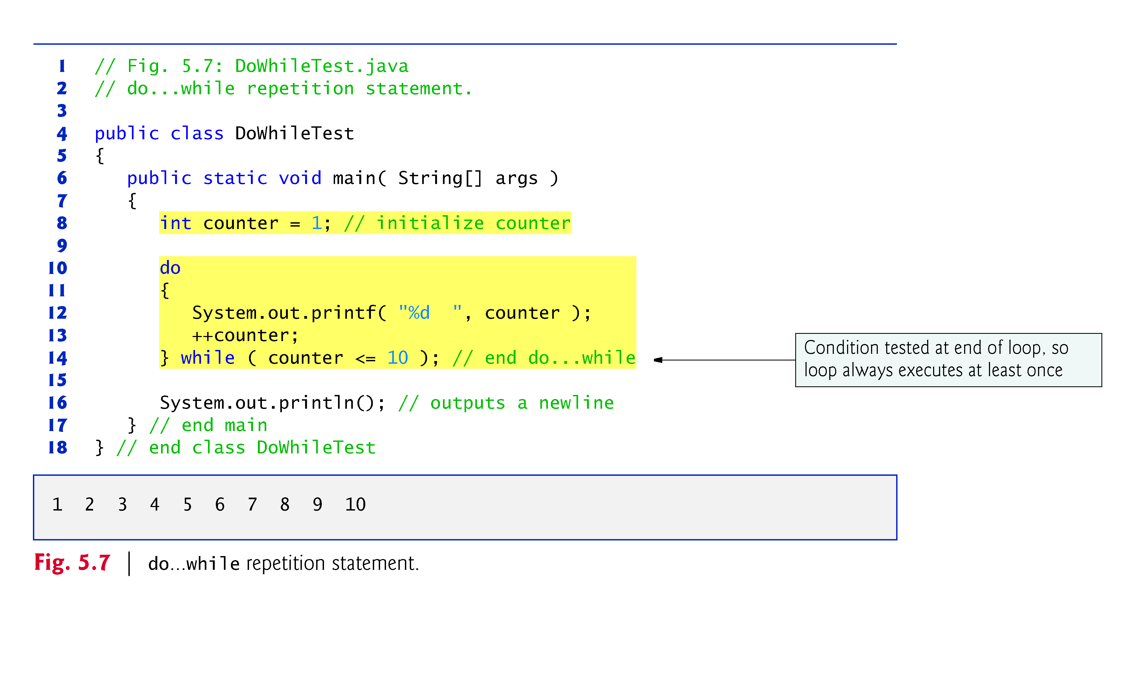

Slide 44
5.5 do…while Repetition Statement (Cont.)
Figure 5.8 contains the UML activity diagram for the do…while statement.
The diagram makes it clear that the loop-continuation condition is not evaluated until after the loop performs the action state at least once.

Slide 45
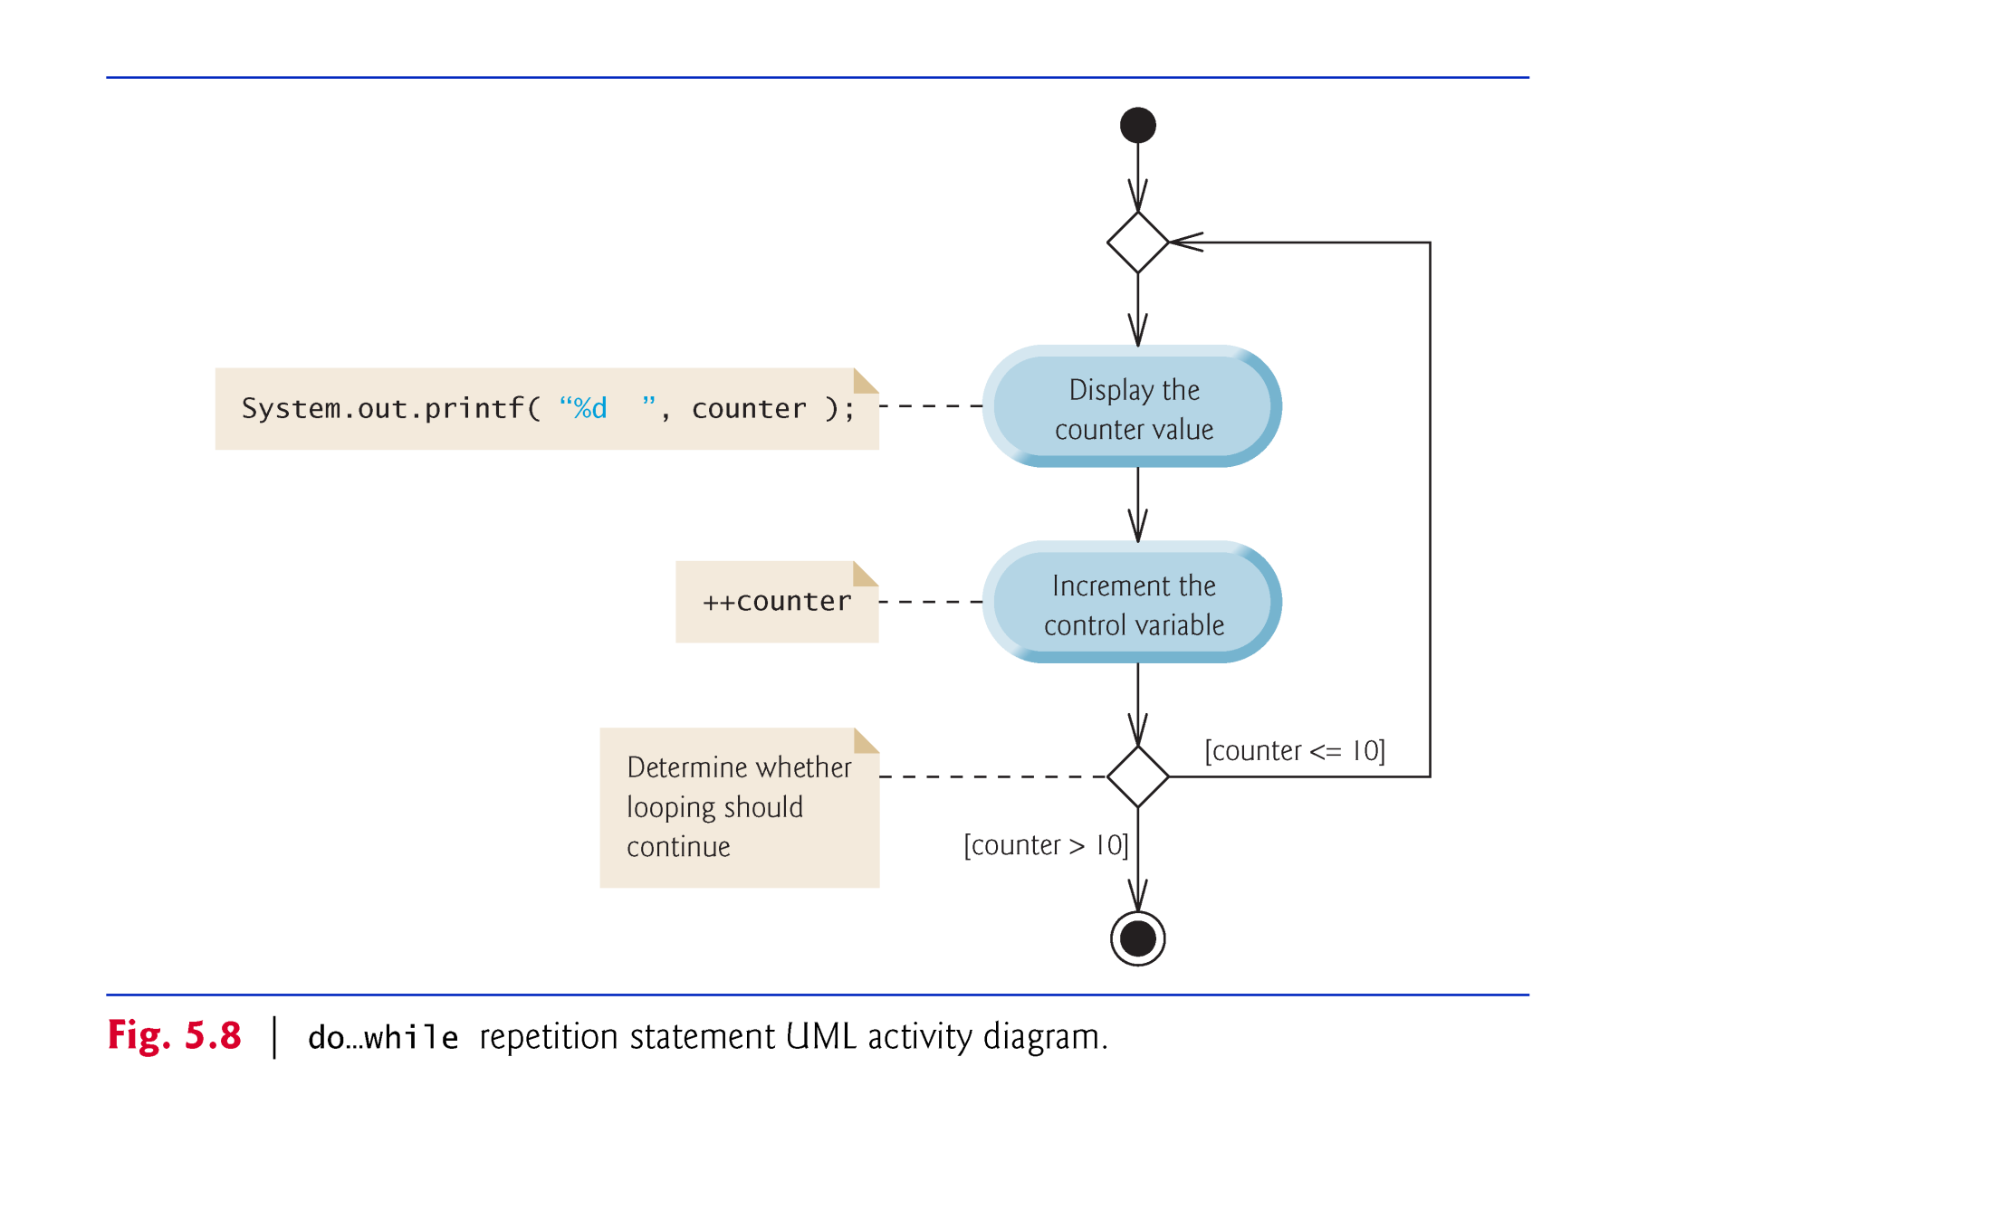

Slide 46
5.5 do…while Repetition Statement (Cont.)
Braces are not required in the do…while repetition statement if there’s only one statement in the body.
Most programmers include the braces, to avoid confusion between the while and do…while statements.
Thus, the do…while statement with one body statement is usually written as follows:
do { statement } while ( condition );

Slide 47
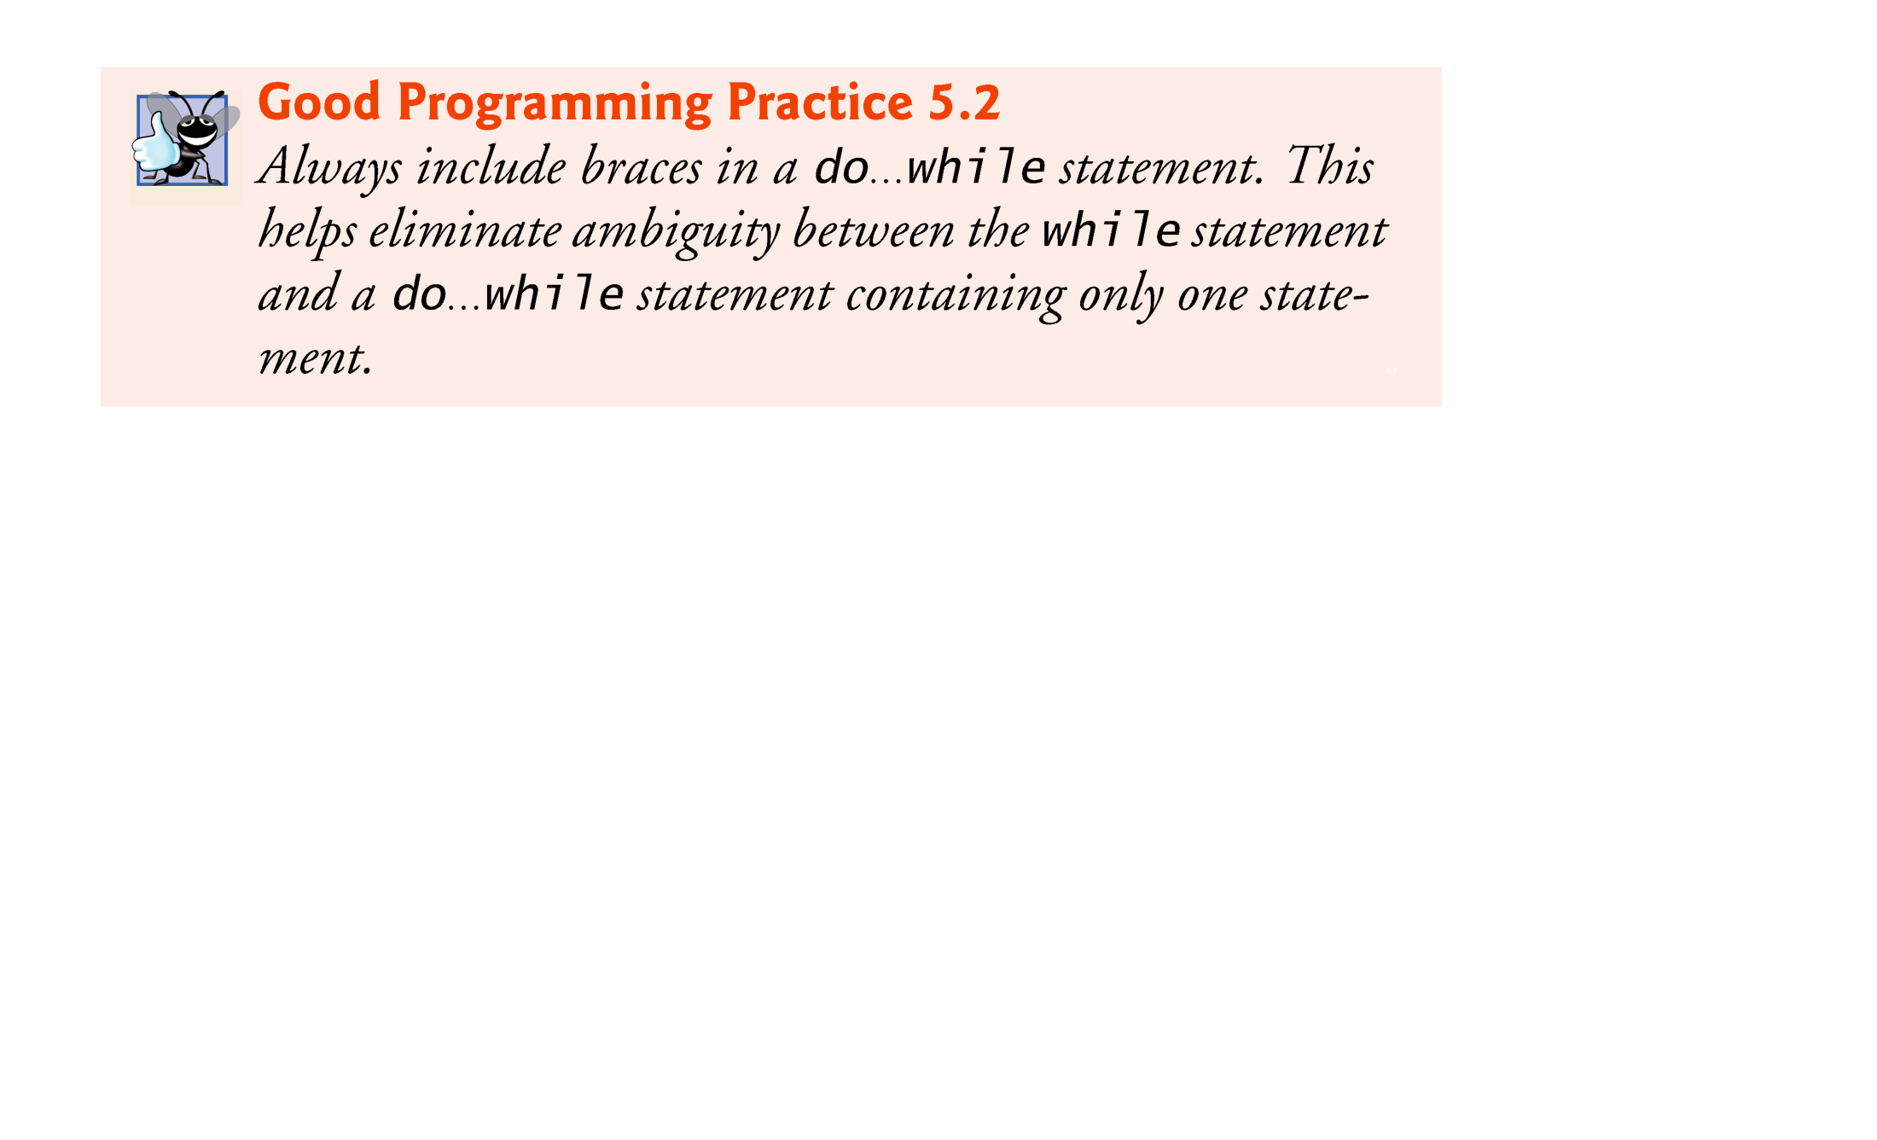

Slide 48
5.6 switch Multiple-Selection Statement
switch multiple-selection statement performs different actions based on the possible values of a constant integral expression of type byte, short, int or char.

Slide 49
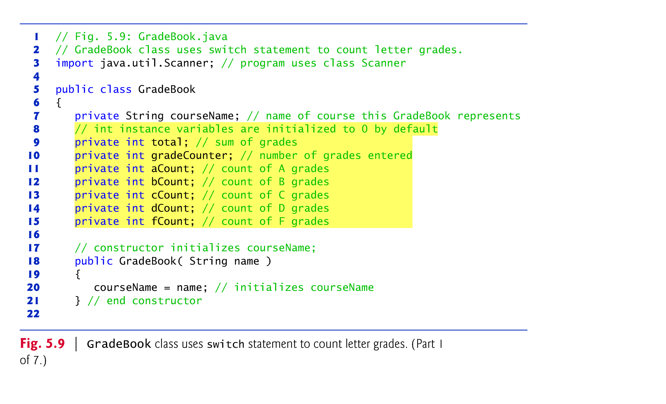

Slide 50
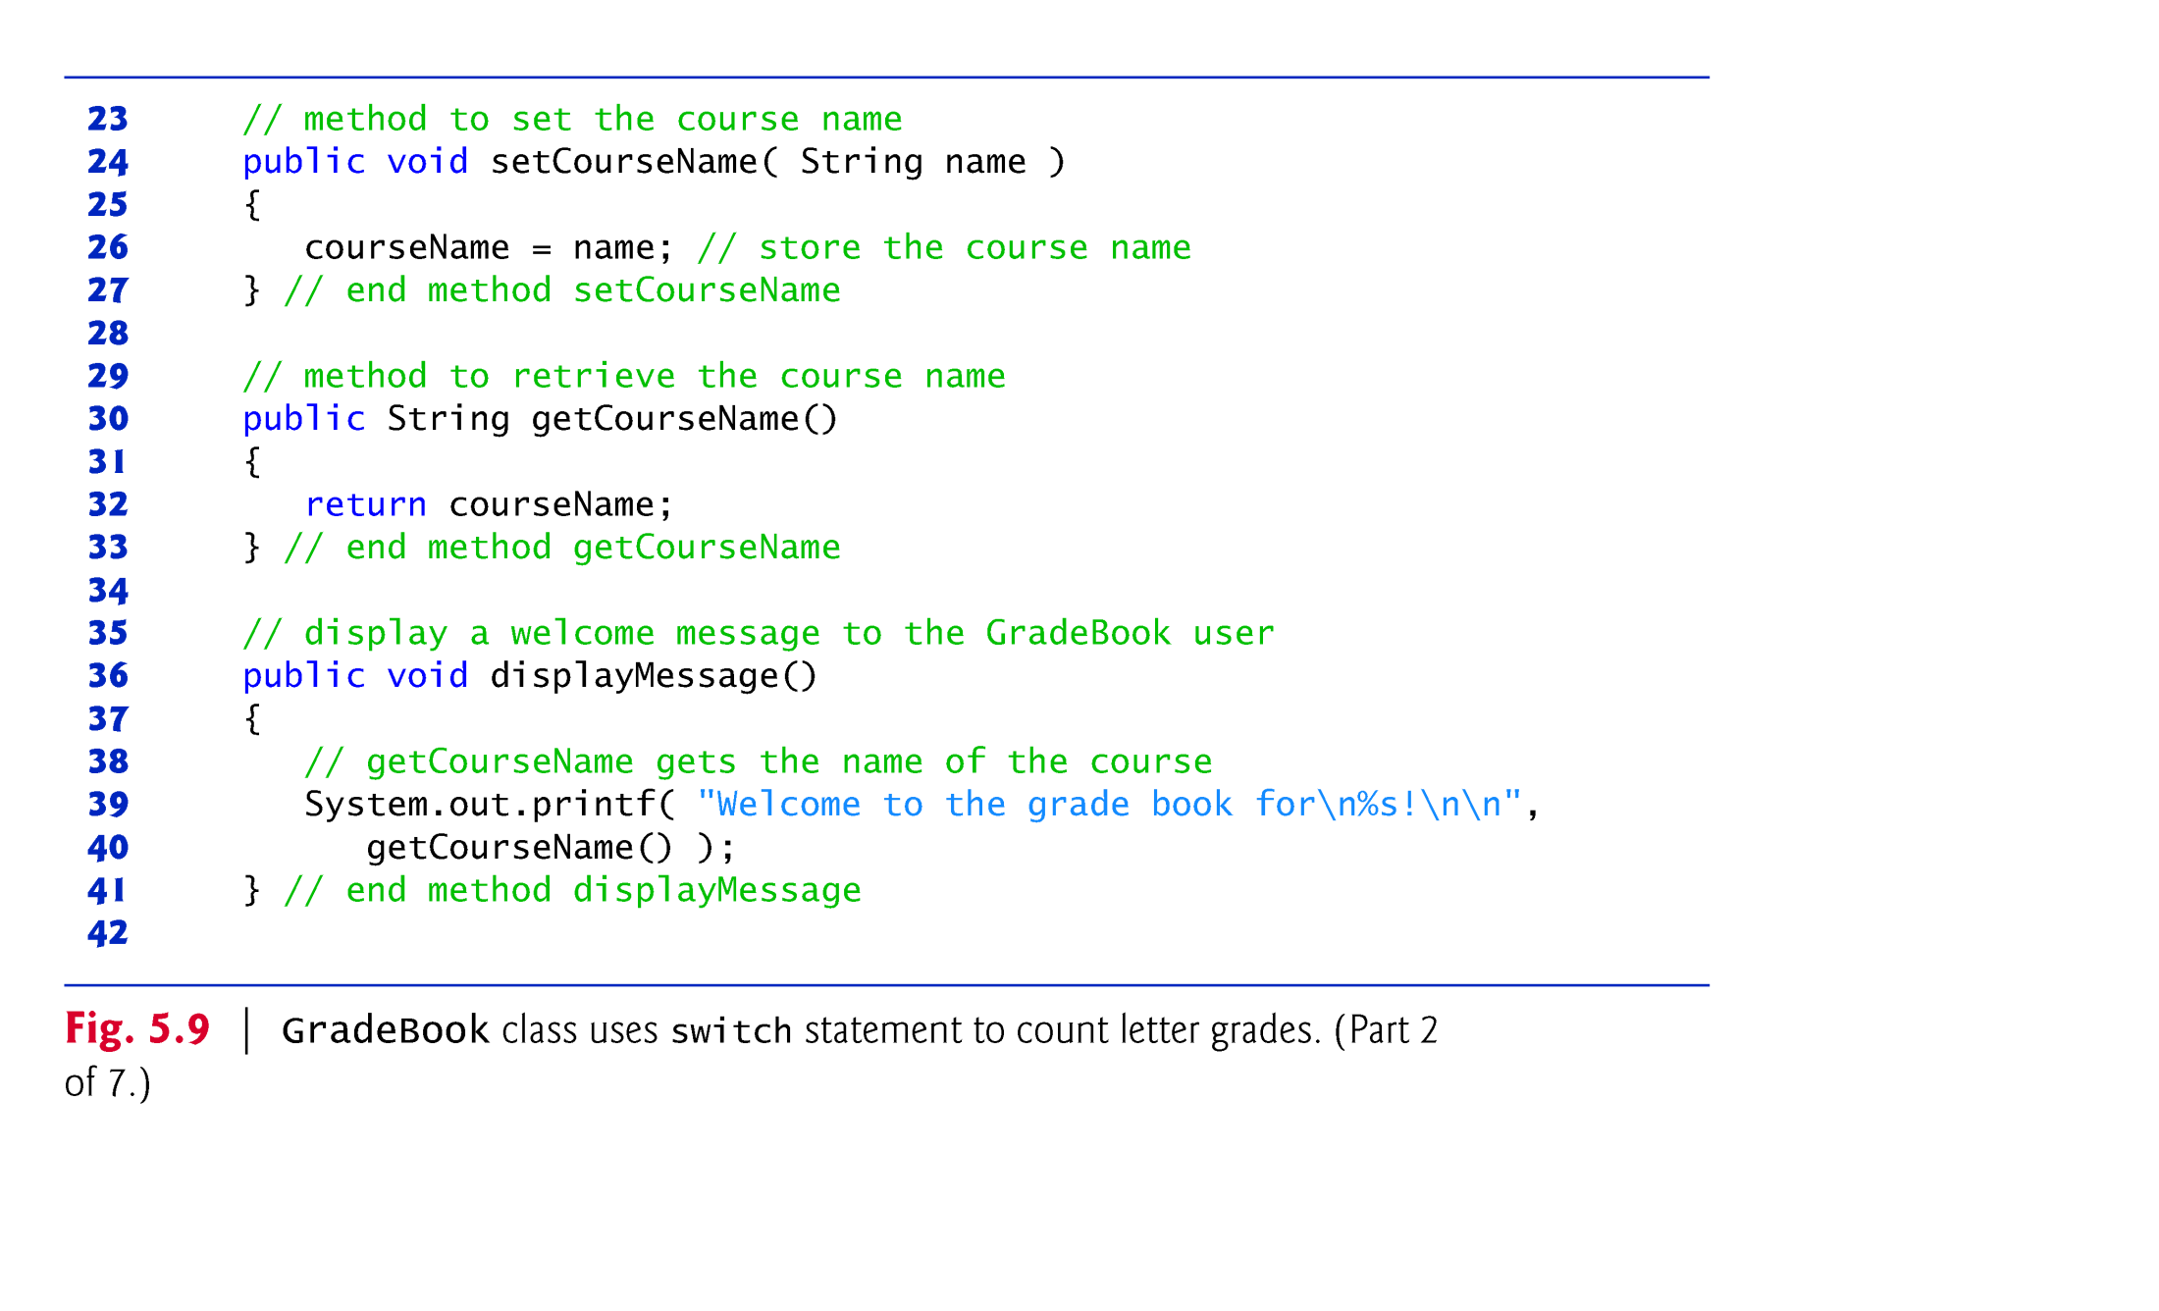

Slide 51
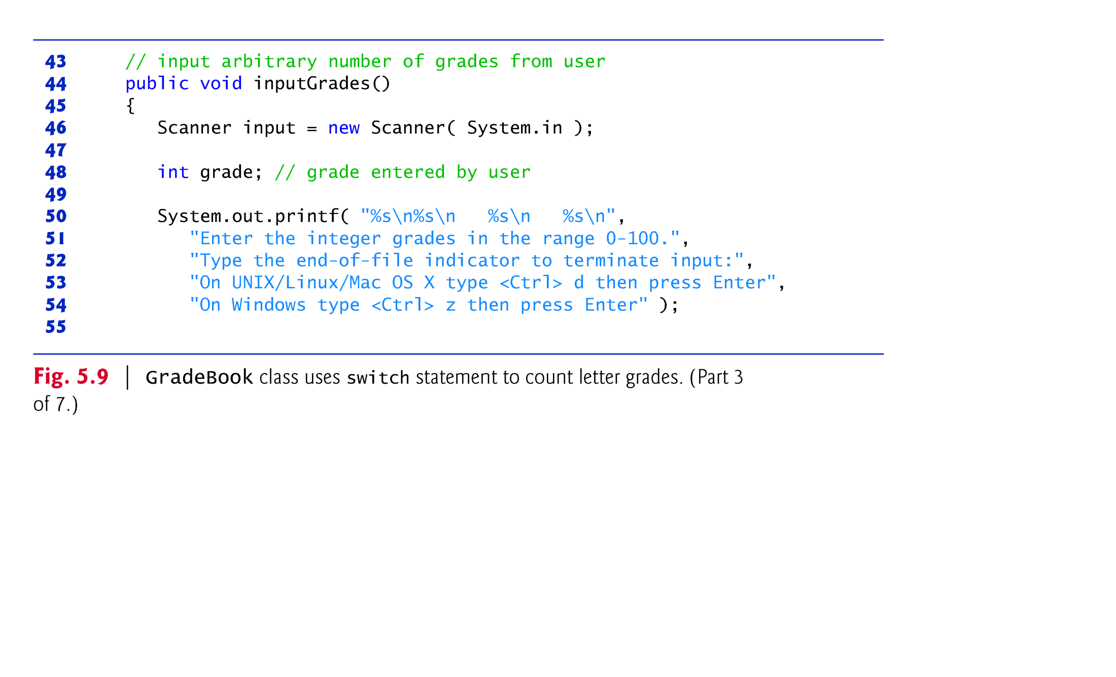

Slide 52
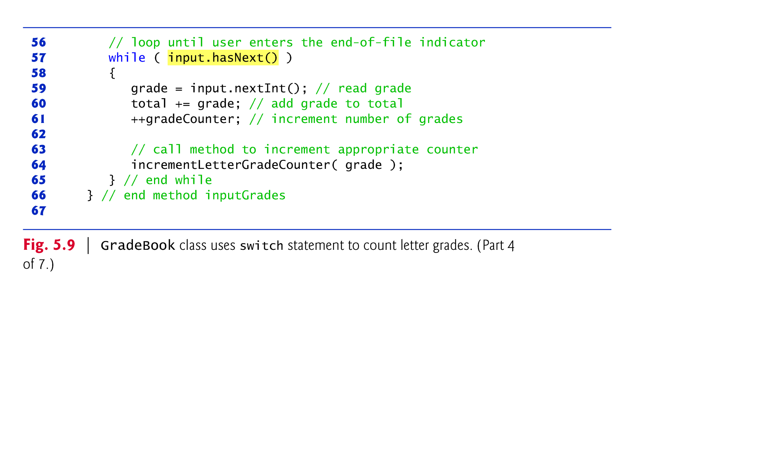

Slide 53
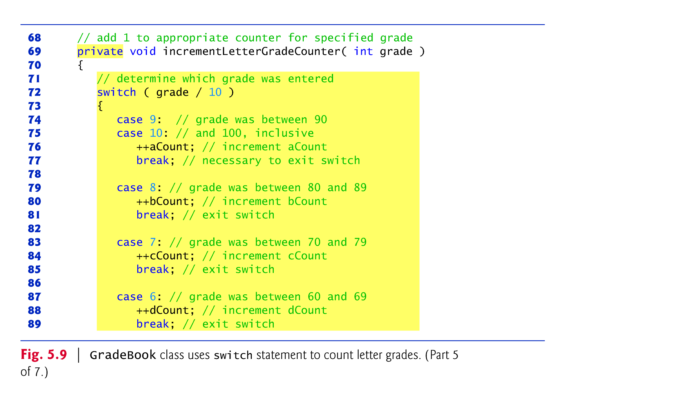

Slide 54
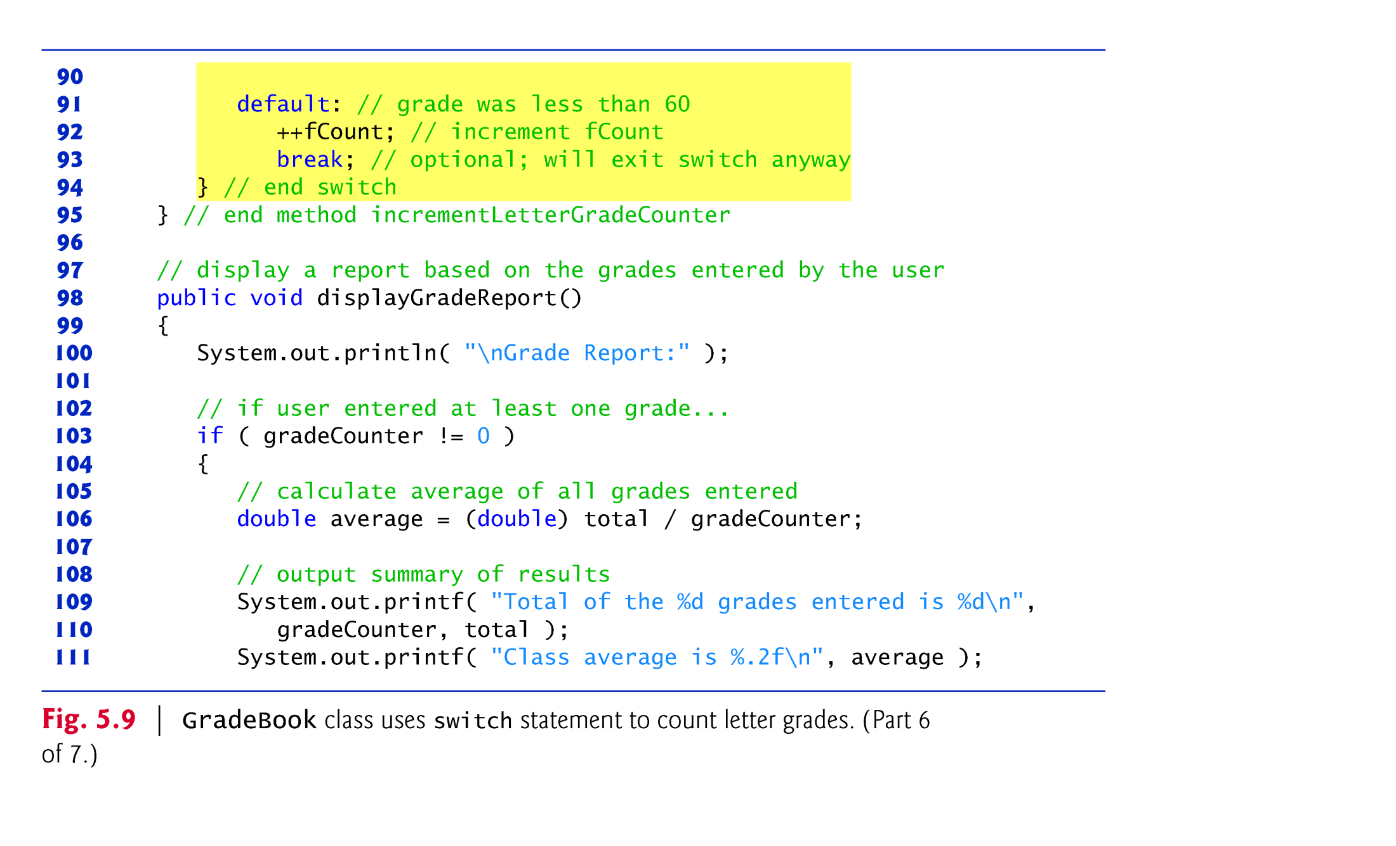

Slide 55
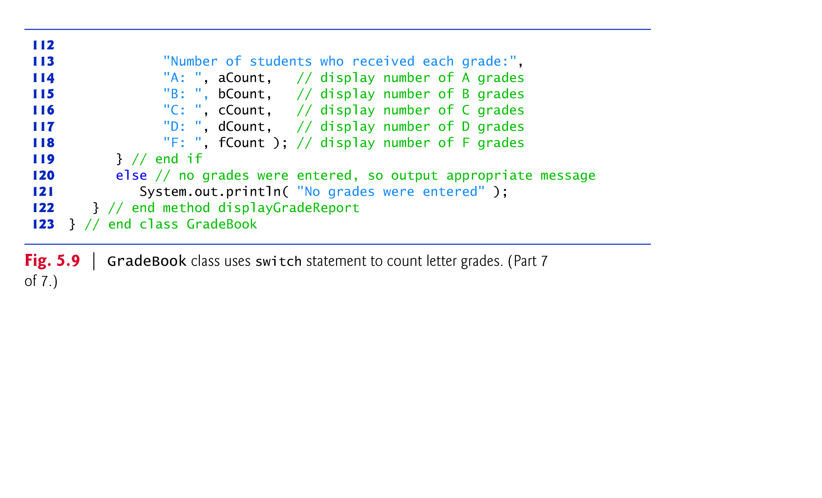

Slide 56
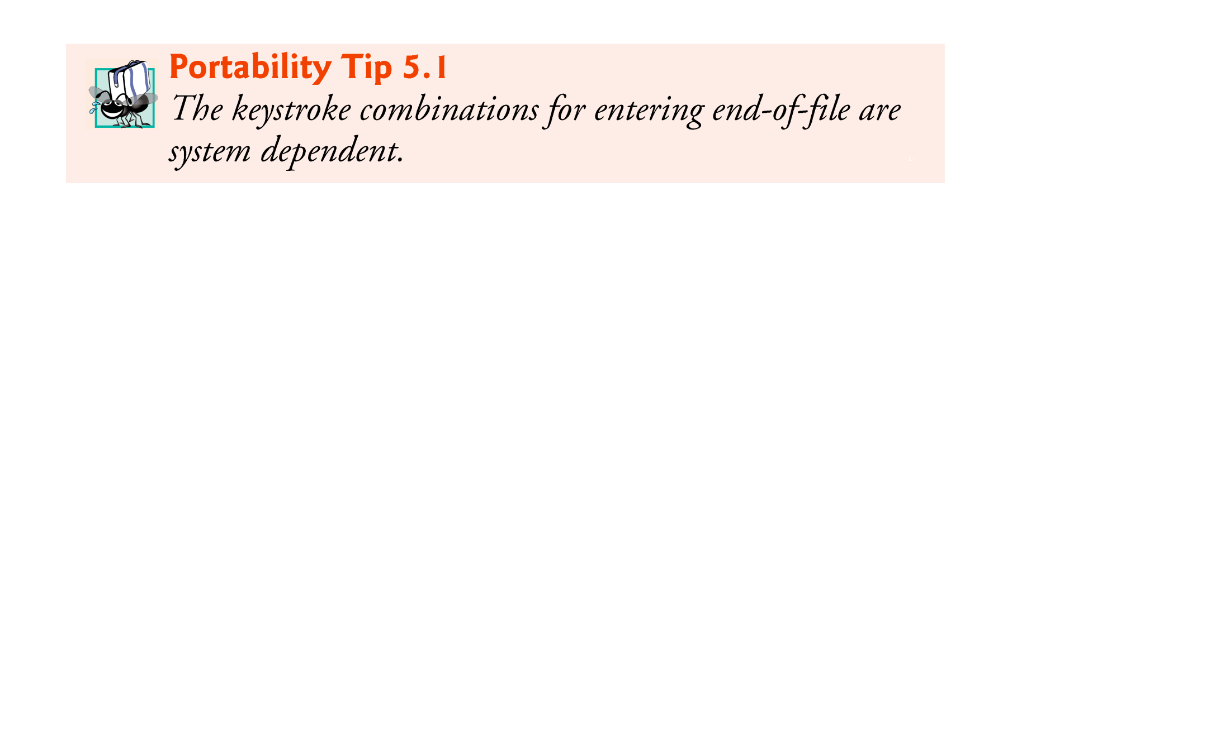

Slide 57


Slide 58
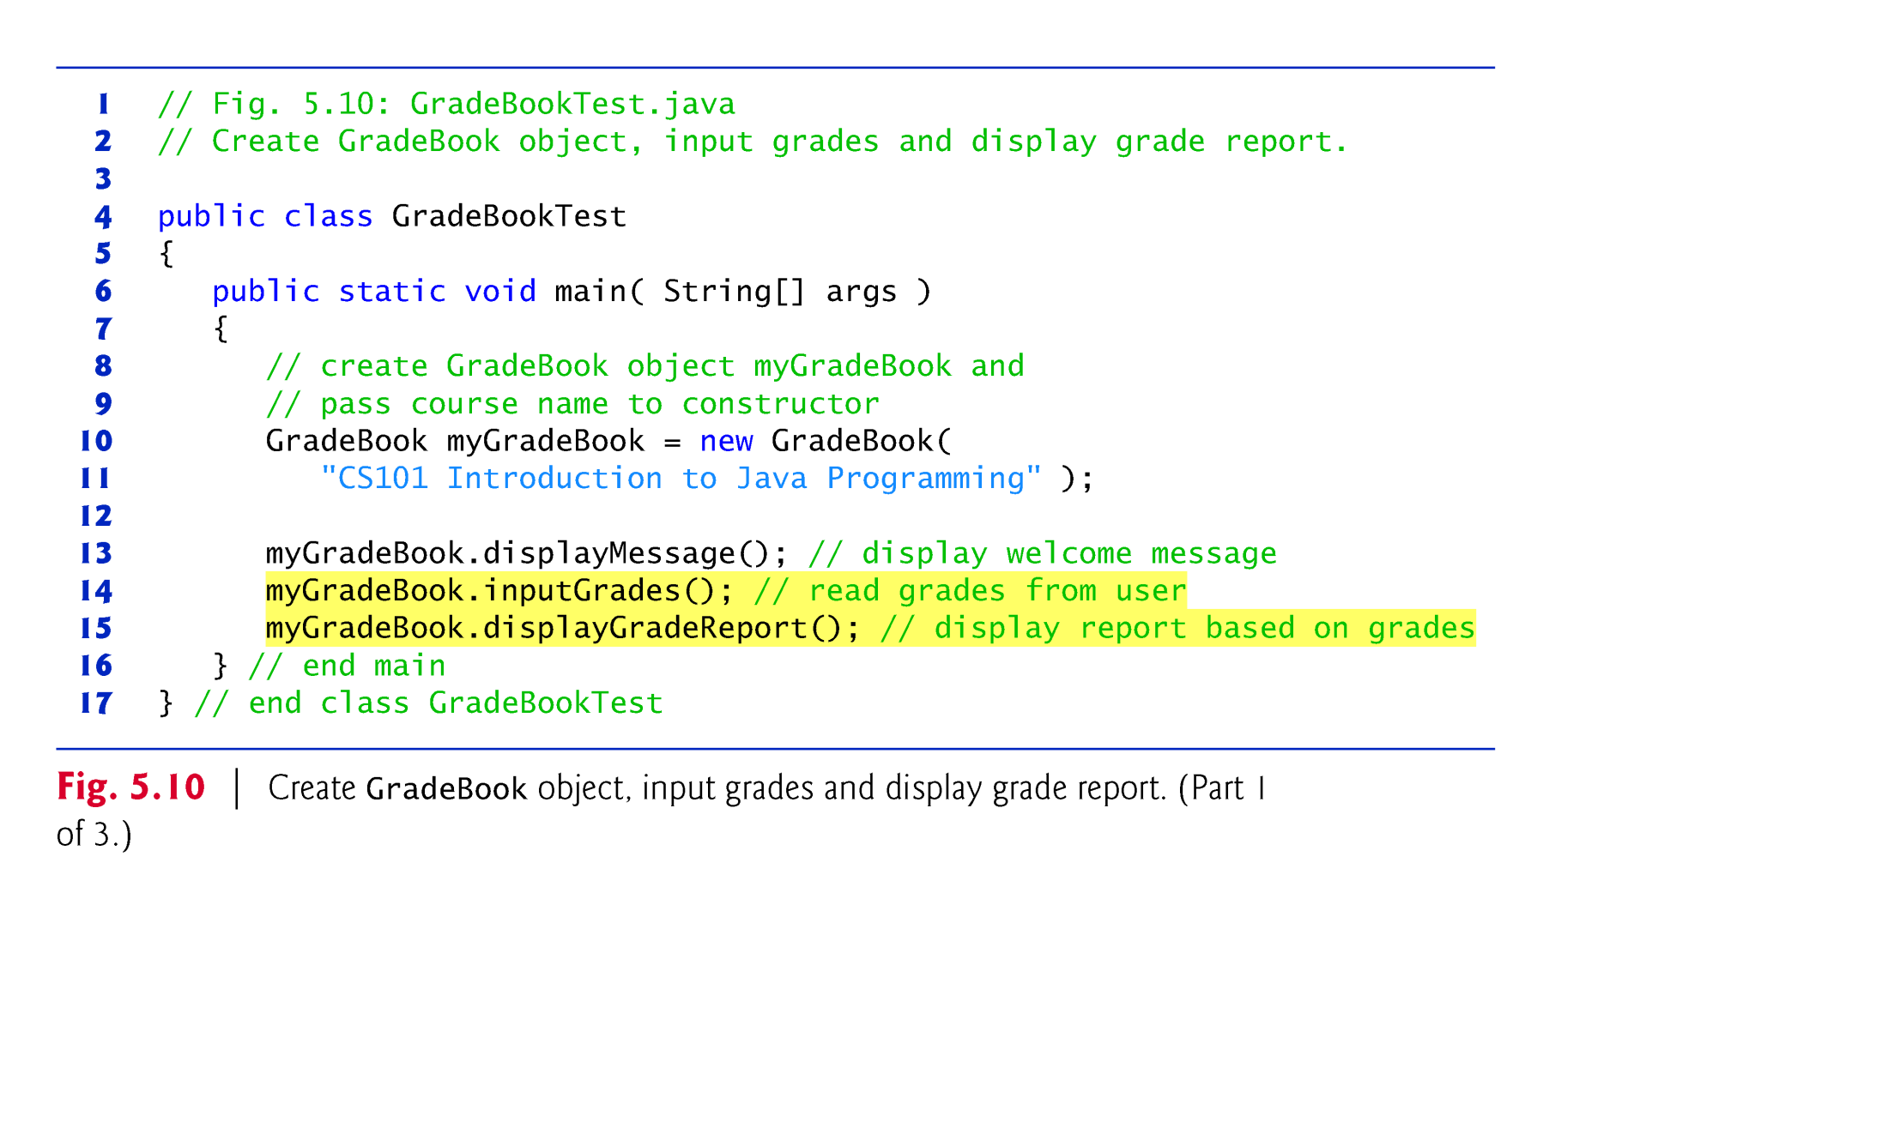

Slide 59
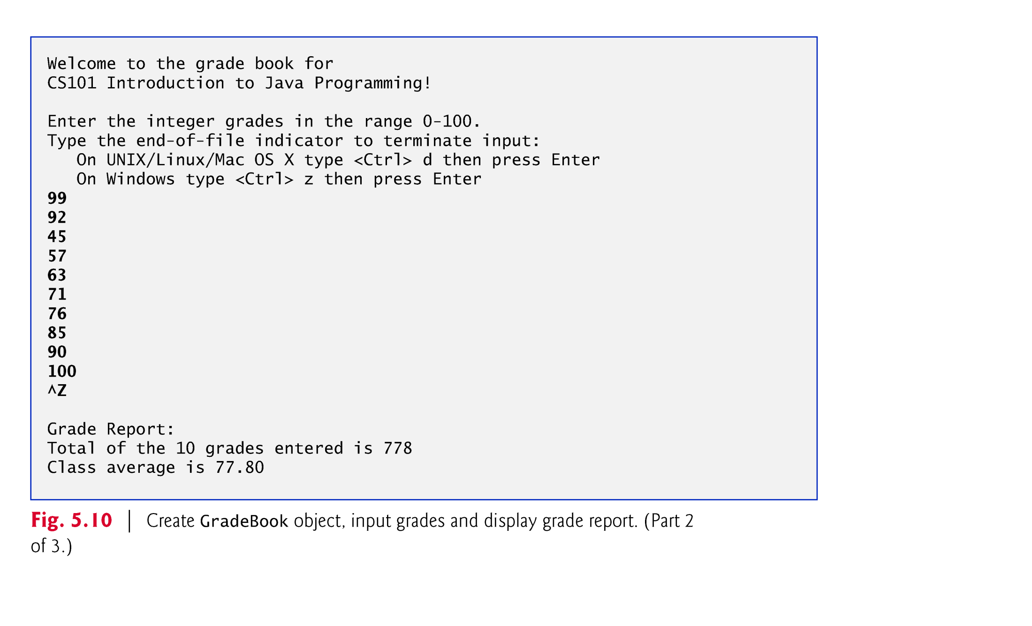

Slide 60
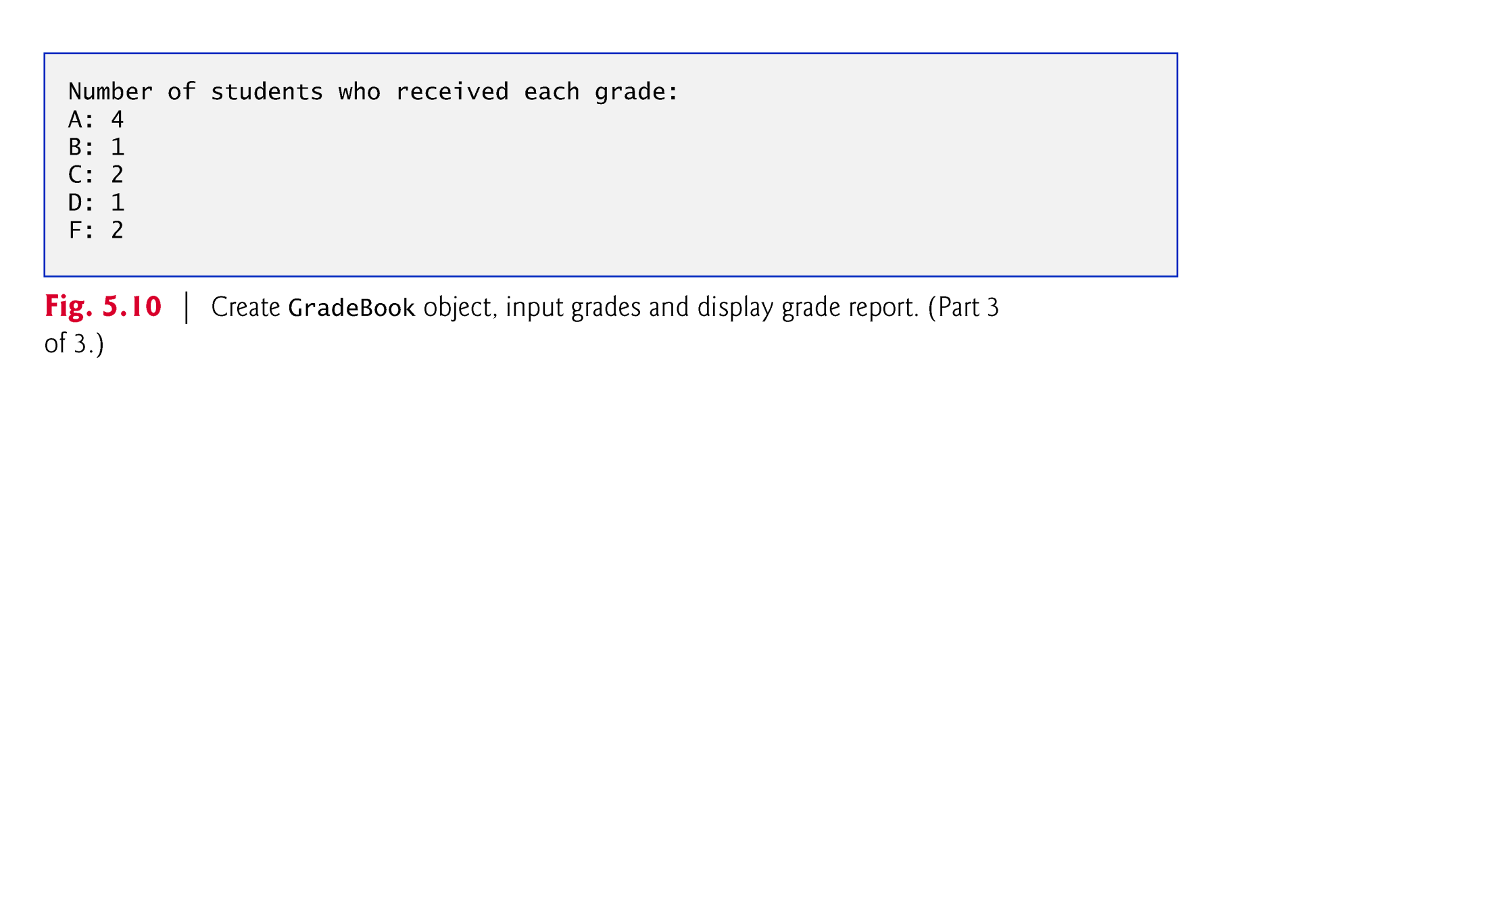

Slide 61
5.6 switch Multiple-Selection Statement (Cont.)
The end-of-file indicator is a system-dependent keystroke combination which the user enters to indicate that there is no more data to input.
On UNIX/Linux/Mac OS X systems, end-of-file is entered by typing the sequence
<Ctrl> d
on a line by itself. This notation means to simultaneously press both the Ctrl key and the d key.
On Windows systems, end-of-file can be entered by typing
<Ctrl> z
On some systems, you must press Enter after typing the end-of-file key sequence.
Windows typically displays the characters ^Z on the screen when the end-of-file indicator is typed.

Slide 62
5.6 switch Multiple-Selection Statement (Cont.)
Scanner method hasNext determine whether there is more data to input. This method returns the boolean value true if there is more data; otherwise, it returns false.
As long as the end-of-file indicator has not been typed, method hasNext will return true.

Slide 63
5.6 switch Multiple-Selection Statement (Cont.)
The switch statement consists of a block that contains a sequence of case labels and an optional default case.
The program evaluates the controlling expression in the parentheses following keyword switch.
The program compares the controlling expression’s value (which must evaluate to an integral value of type byte, char, short or int) with each case label.
If a match occurs, the program executes that case’s statements.
The break statement causes program control to proceed with the first statement after the switch.

Slide 64
5.6 switch Multiple-Selection Statement (Cont.)
switch does not provide a mechanism for testing ranges of values—every value must be listed in a separate case label.
Note that each case can have multiple statements.
switch differs from other control statements in that it does not require braces around multiple statements in a case.
Without break, the statements for a matching case and subsequent cases execute until a break or the end of the switch is encountered. This is called “falling through.”
If no match occurs between the controlling expression’s value and a case label, the default case executes.
If no match occurs and there is no default case, program control simply continues with the first statement after the switch.

Slide 65
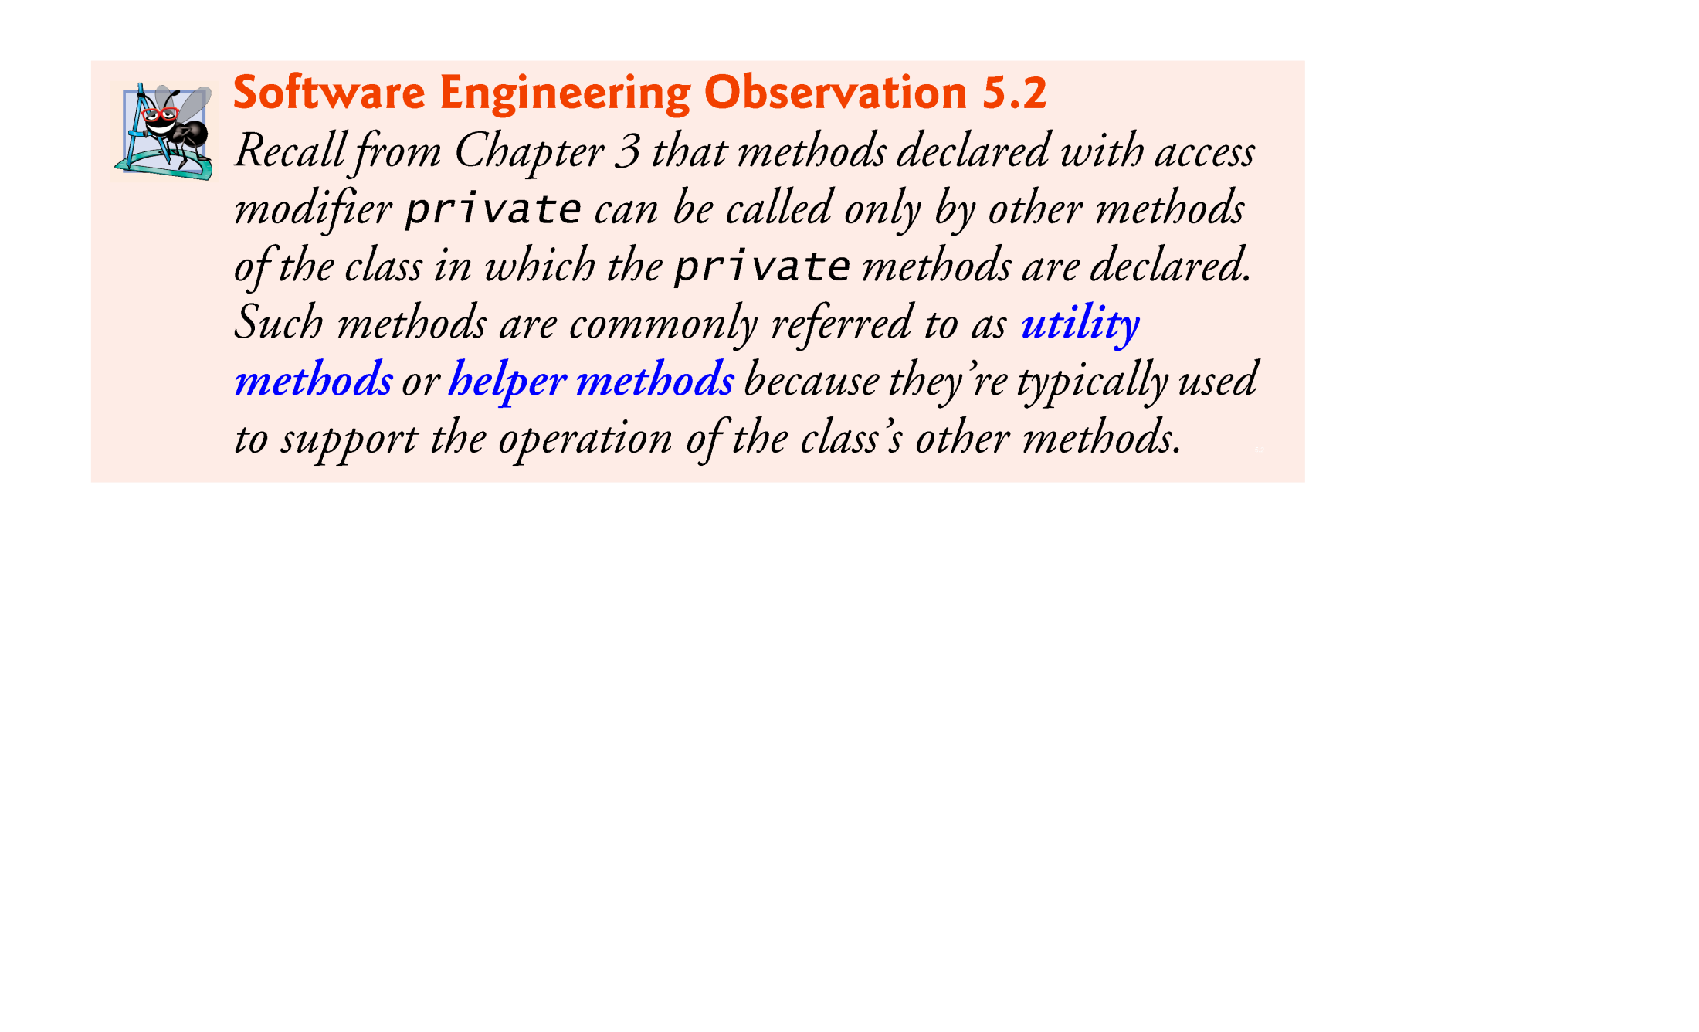

Slide 66
5.6 switch Multiple-Selection Statement (Cont.)
Figure 5.11 shows the UML activity diagram for the general switch statement.
Most switch statements use a break in each case to terminate the switch statement after processing the case.
The break statement is not required for the switch’s last case (or the optional default case, when it appears last), because execution continues with the next statement after the switch.

Slide 67
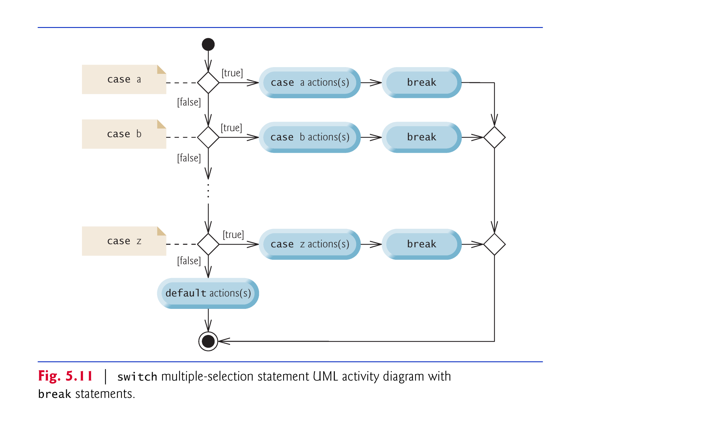

Slide 68


Slide 69


Slide 70
5.6 switch Multiple-Selection Statement (Cont.)
When using the switch statement, remember that each case must contain a constant integral expression.
An integer constant is simply an integer value.
In addition, you can use character constants—specific characters in single quotes, such as 'A', '7' or '$'—which represent the integer values of characters.
The expression in each case can also be a constant variable—a variable that contains a value which does not change for the entire program. Such a variable is declared with keyword final.
Java has a feature called enumerations. Enumeration constants can also be used in case labels.

Slide 71
5.6 switch Multiple-Selection Statement (Cont.)
As of Java SE 7, you can use Strings in a switch statement’s controlling expression and in case labels as in:
switch( city ) { case "Maynard": zipCode = "01754"; break; case "Marlborough": zipCode = "01752"; break; case "Framingham": zipCode = "01701"; break; } // end switch

Slide 72
5.7 break and continue Statements
The break statement, when executed in a while, for, do…while or switch, causes immediate exit from that statement.
Execution continues with the first statement after the control statement.
Common uses of the break statement are to escape early from a loop or to skip the remainder of a switch.

Slide 73
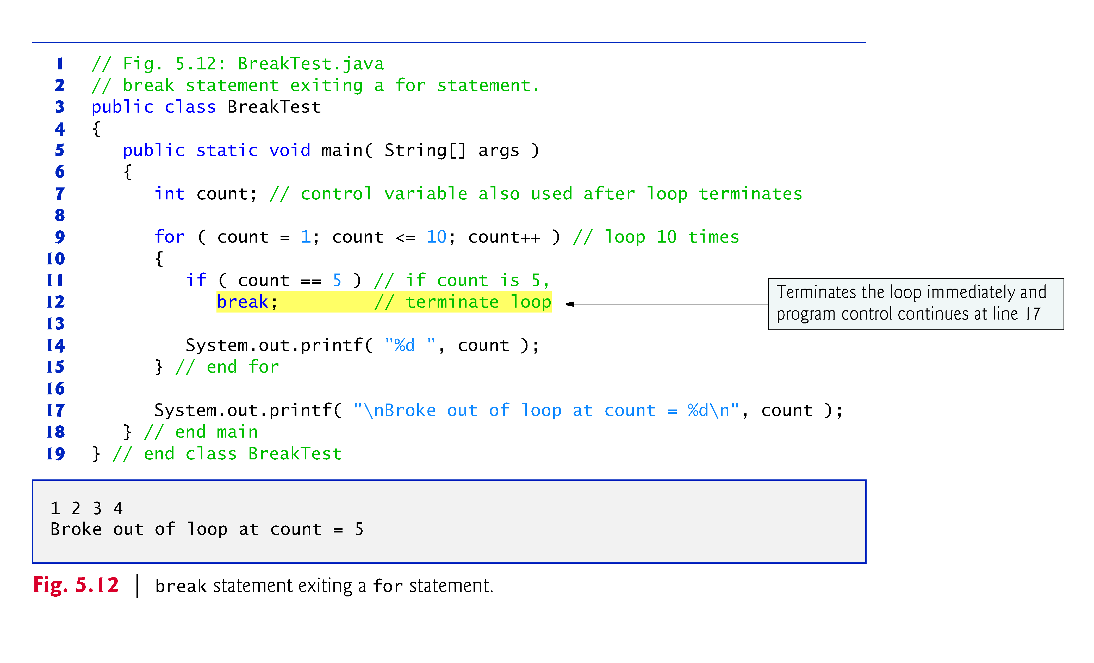

Slide 74
5.7 break and continue Statements (Cont.)
The continue statement, when executed in a while, for or do…while, skips the remaining statements in the loop body and proceeds with the next iteration of the loop.
In while and do…while statements, the program evaluates the loop-continuation test immediately after the continue statement executes.
In a for statement, the increment expression executes, then the program evaluates the loop-continuation test.

Slide 75
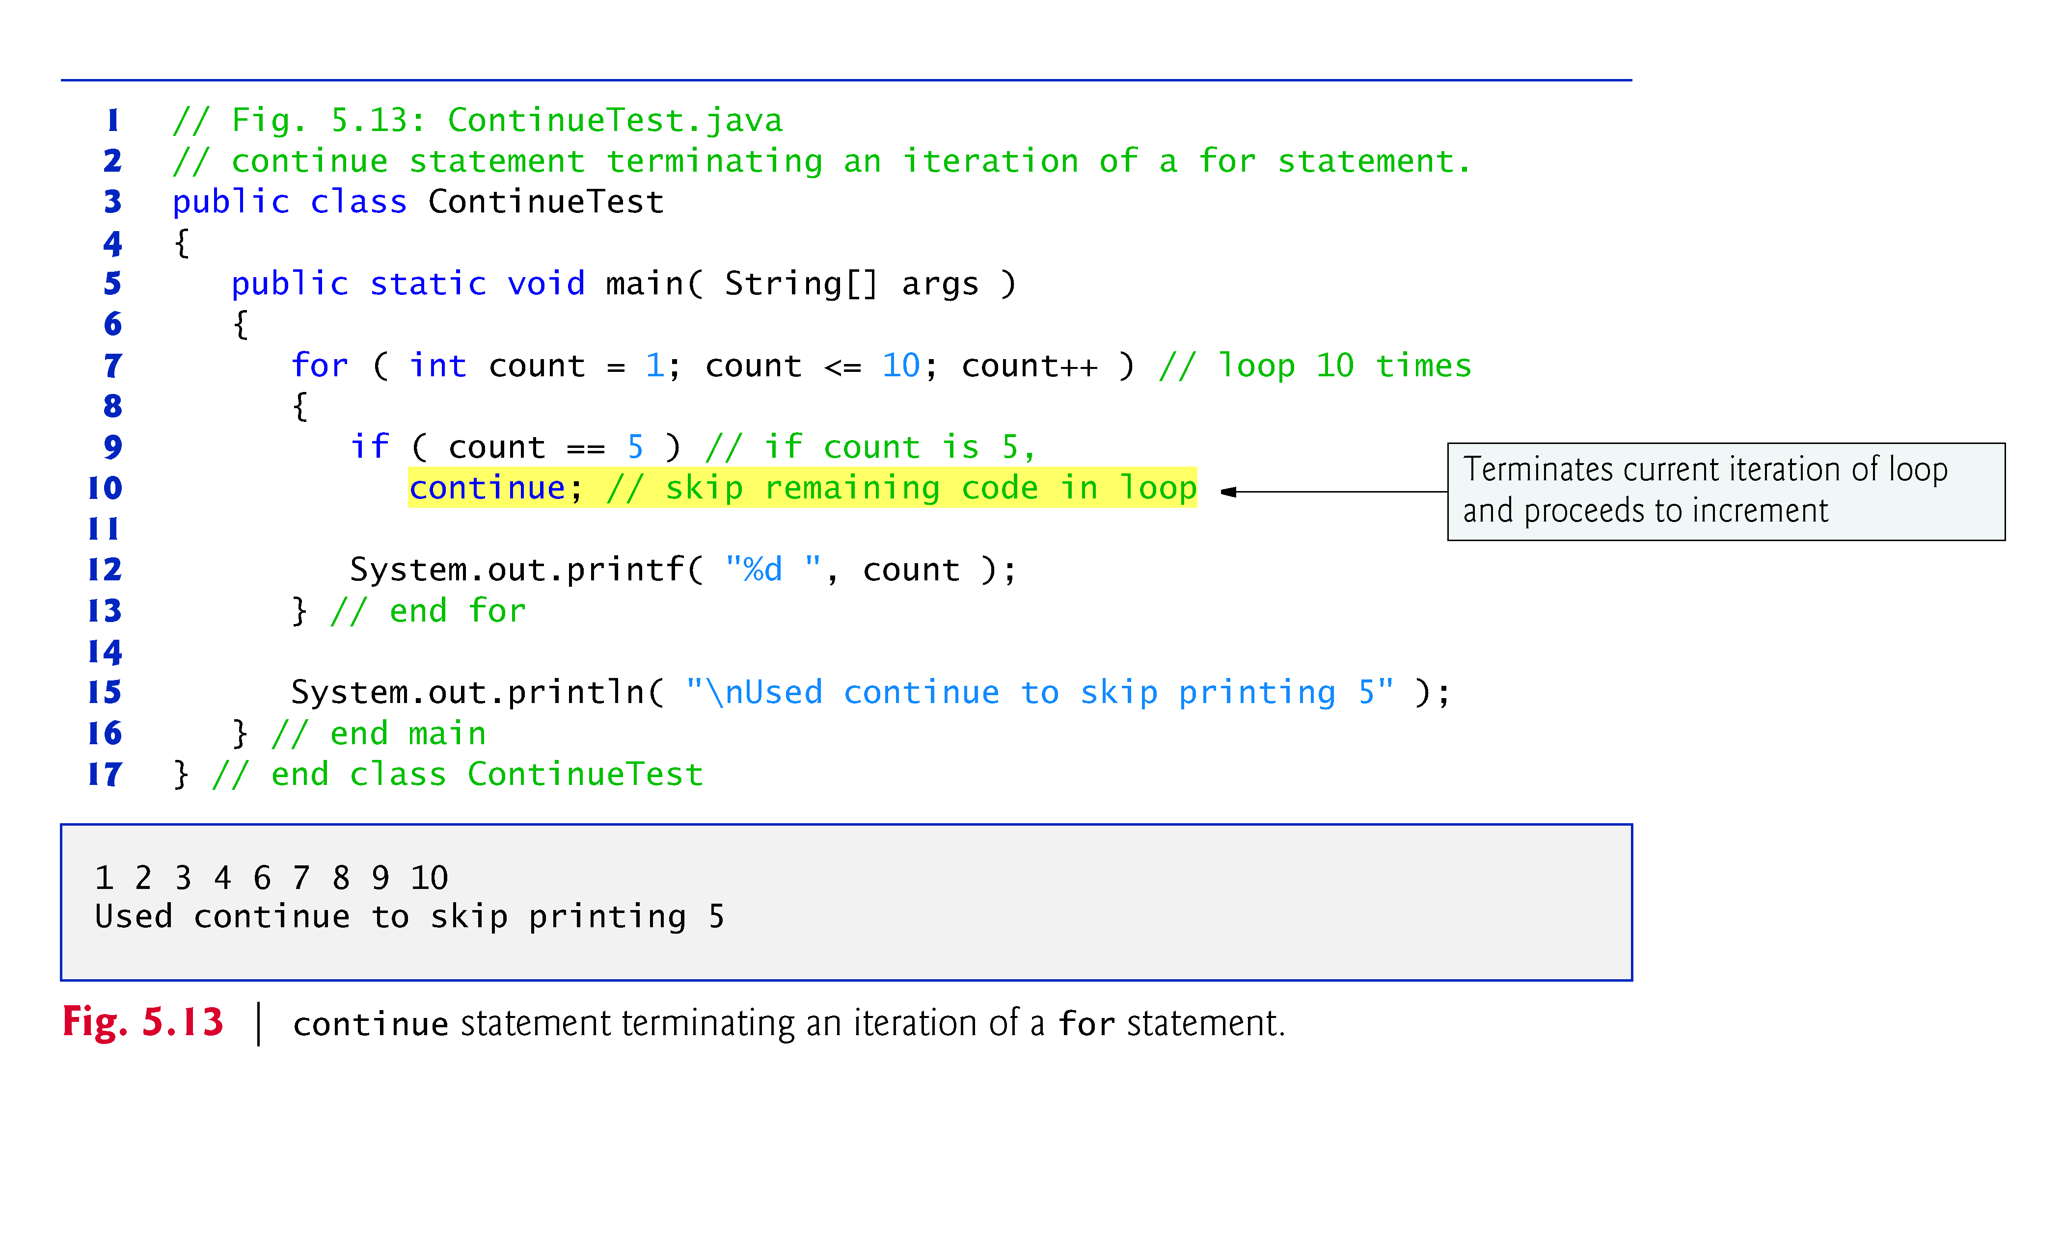

Slide 76
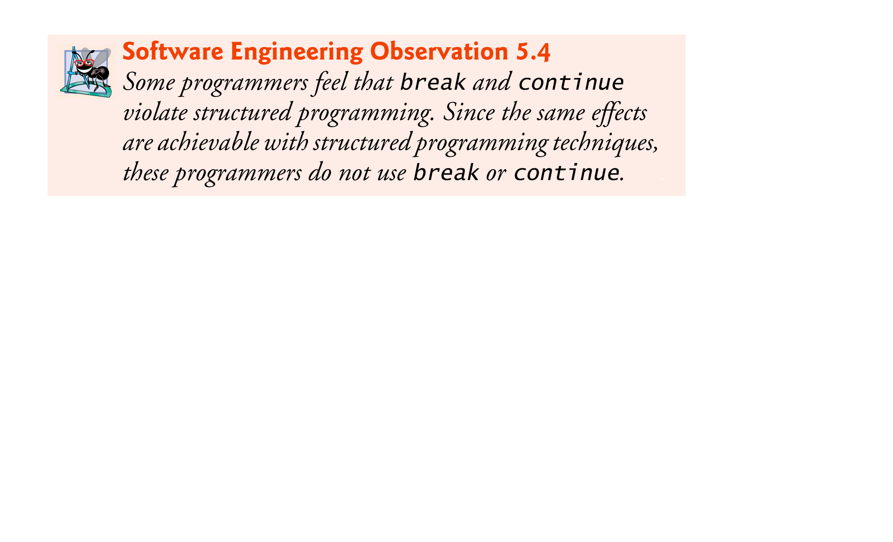

Slide 77
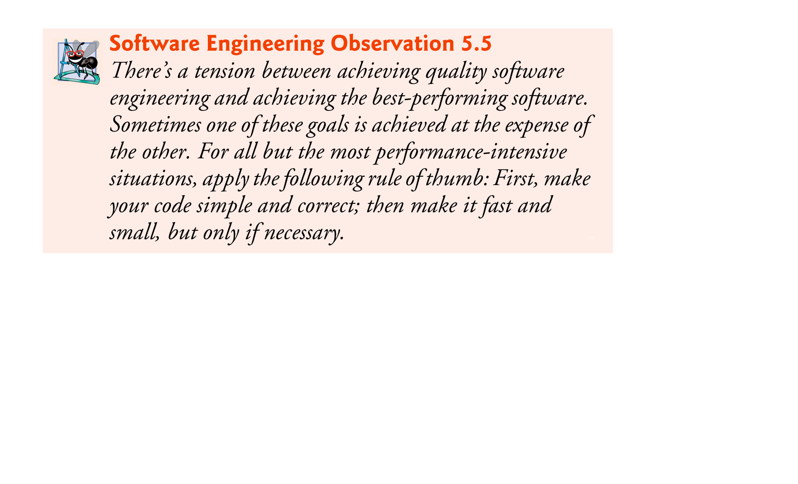

Slide 78
5.8 Logical Operators
Java’s logical operators enable you to form more complex conditions by combining simple conditions.
The logical operators are
&& (conditional AND)
|| (conditional OR)
& (boolean logical AND)
| (boolean logical inclusive OR)
^ (boolean logical exclusive OR)
! (logical NOT).
[Note: The &, | and ^ operators are also bitwise operators when they are applied to integral operands.]

Slide 79
5.8 Logical Operators (Cont.)
The & (conditional AND) operator ensures that two conditions are both true before choosing a certain path of execution.
The table in Fig. 5.14 summarizes the && operator. The table shows all four possible combinations of false and true values for expression1 and expression2.
Such tables are called truth tables. Java evaluates to false or true all expressions that include relational operators, equality operators or logical operators.

Slide 80
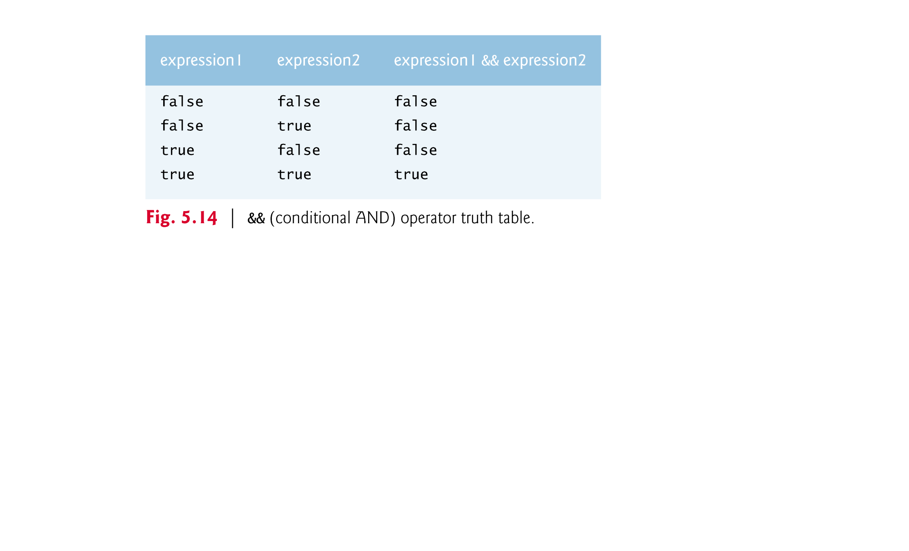

Slide 81
5.8 Logical Operators (Cont.)
The || (conditional OR) operator ensures that either or both of two conditions are true before choosing a certain path of execution.
Figure 5.15 is a truth table for operator conditional OR (||).
Operator && has a higher precedence than operator ||.
Both operators associate from left to right.

Slide 82
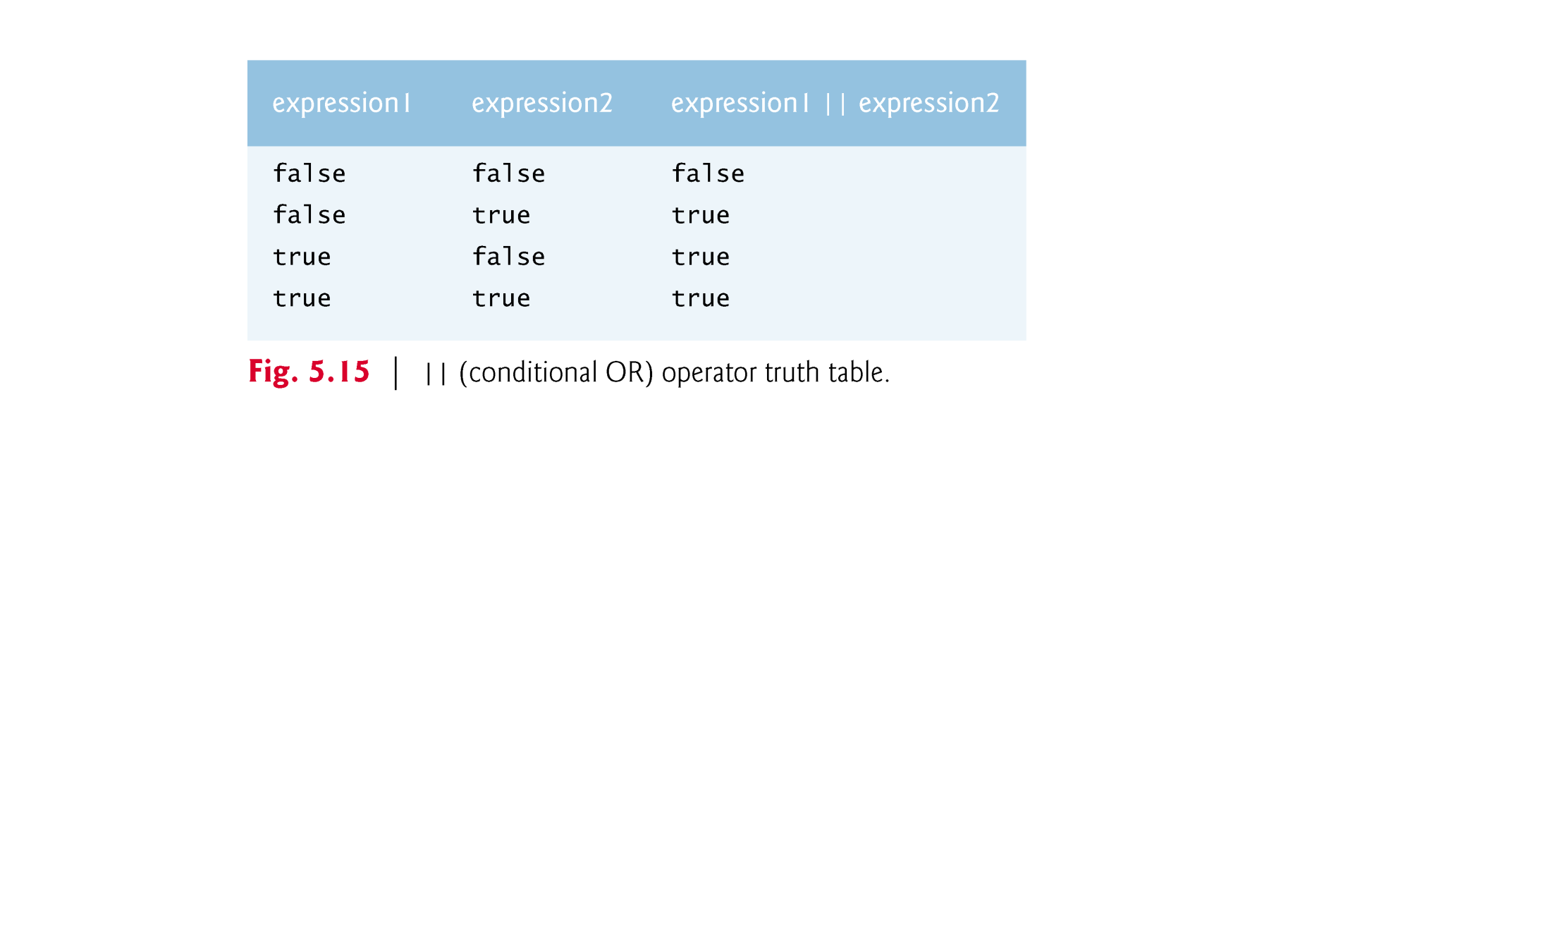

Slide 83
5.9 Structured Programming Summary (Cont.)
Structured programming promotes simplicity.
Bohm and Jacopini: Only three forms of control are needed to implement an algorithm:
Sequence
Selection
Repetition
The sequence structure is trivial. Simply list the statements to execute in the order in which they should execute.

Slide 84
5.9 Structured Programming Summary (Cont.)
Selection is implemented in one of three ways:
if statement (single selection)
if…else statement (double selection)
switch statement (multiple selection)
The simple if statement is sufficient to provide any form of selection—everything that can be done with the if…else statement and the switch statement can be implemented by combining if statements.

Slide 85
5.9 Structured Programming Summary (Cont.)
Repetition is implemented in one of three ways:
while statement
do…while statement
for statement
The while statement is sufficient to provide any form of repetition. Everything that can be done with do…while and for can be done with the while statement.

Slide 86
5.9 Structured Programming Summary (Cont.)
Combining these results illustrates that any form of control ever needed in a Java program can be expressed in terms of
sequence
if statement (selection)
while statement (repetition)
and that these can be combined in only two ways—stacking and nesting.

